Slide 1
The Phosphorylation Potential
Determination and Uses in Disease
Richard L Veech, MD DPhil
Lab of Metabolic Control, NIH

Slide 2
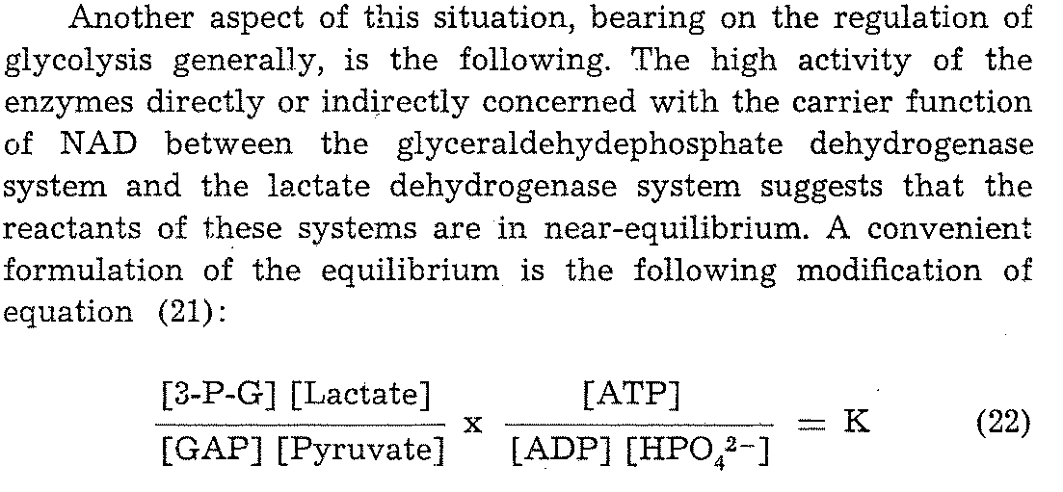
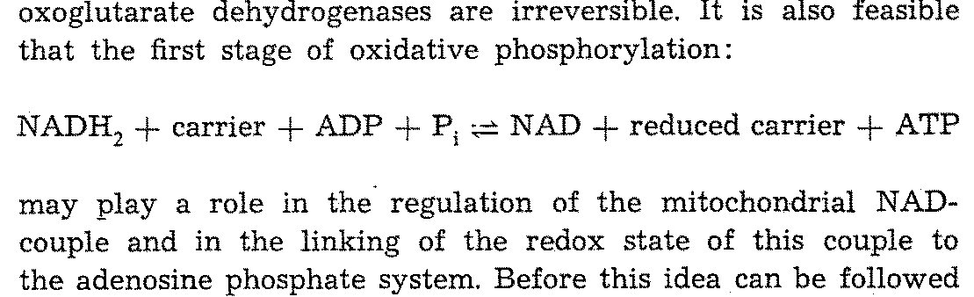
In 1968 Krebs and Veech Proposed The Ratio of ATP/ADPxPi is Related to the Both
the Cytosolic and Mitochondrial Redox States Through the GAPDH+ 3PGK Reaction
and Electron Transport
The Energy Level and Metabolic Control in Mitochondria, Krebs, HA , Veech RL
Pp 329-382, Ed Papa, S. et al, Adriatica Editrice, Bari

Slide 3
The Relation of the Phosphorylation Potential to the Cytosolic Redox State and The Respiratory Chain was Proposed in 1968 but It Took 10 and 30 Years to Prove
In 1968 we did not recognize that changes in free [Mg²⁺ ]would alter the value of Keq
The value of free [Mg2+] in cells was not known and had to be determined.
Next Keq had to be determined as function of [Mg²⁺]
Finally the value of the mitochondrial membrane potential had to be determined and related the the ΔG of ATP hydrolysis and redox state of the chain.

Slide 4
Free Intracellular [Mg²⁺] ranges from 0.2 to 1.5 mM and is Reflected by the [Citrate]/[Isocitrate] Ratio

Slide 5
The variation of K’_{GG-(TPI+LDH)} with pH and free [Mg²⁺].

Slide 6
The Cytosolic Phosphorylation Potential J Biol Chem 1979
VeecH, RL, Cornell, N., Lawson, J., Krebs, HA
The ratio of [PCr]/[Cr} and the ratio of [DHAP]x[Lactate]/[3PG]x[Pyruvate]
give the same ATP/ADPxPi ratio yielding a ΔG’ of ATP hydrolysis of -53 to
-59 kJ/mol in brain, muscle, liver and red cell .
The creatine kinase and GAPDH + 3PG kinase reastions are in near equilibrium
with the phosphorylation potential.
Free [ADP] is about 20 μmolar with the major of ADP being segregated within the mitochondrial matrix.

Slide 7
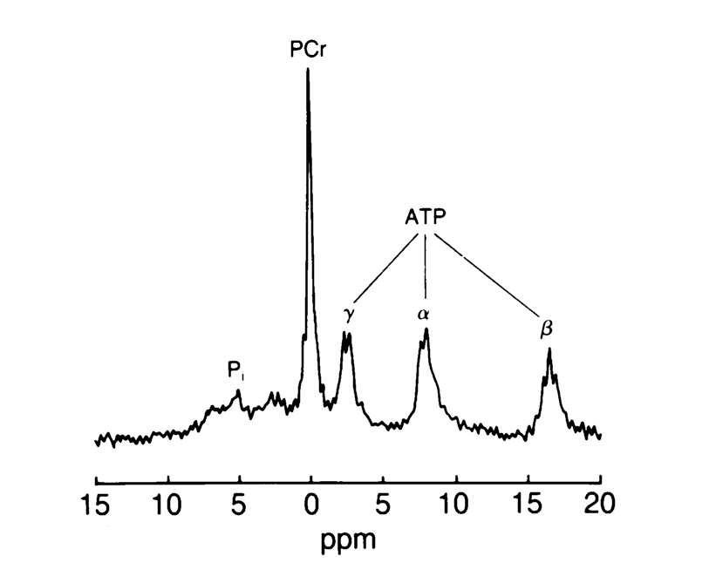
That the free ADP in Cells was Low was Confirmed by NMR
Chance_B_PNAS_1986_83_9458-62_fig4

Slide 8
The Ratio of Free [CoQ]/[CoQH₂] Can Be Calculated from the [fumarate]/[succinate] Ratio
And with that the ΔG ATP between site I and II
Bergman C. et al, JPhysChemB 114: 16137, 2010
Sato K. et al, FASEB J 9: 651,, 1995

Slide 9
In Perfused Heart, Ketone Metabolism Increased ΔG ATP and Mimicked Insulin
FASEB J 9: 651-8, 1995

Slide 10
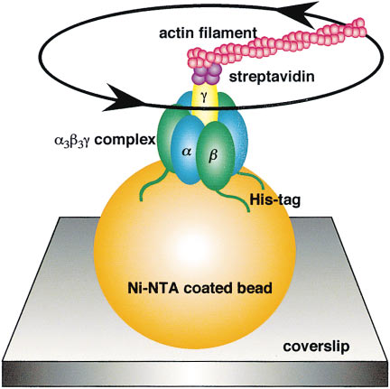
R. Yasuda, et. al. Cell 1998 93(7):1117-24. “F1-ATPase is a highly efficient molecular motor that rotates with discrete 120 degree steps”

Slide 11
Incidence per Year of Disease Phenotype in US Treatable by Ketones
Substrate Insufficiency
US Incidence and Source
Diabetes types I & II
Alzheimer’s
Heart Failure
25 mill NIDDK
5.1 mill Alheimers Org
1.5 mill Am.Heart
1 mill Parkinson Foundation
0.00035 mill ALS Org
30 mill FreeMed
8.5 mill AHA
6.4 mill AHA
33 mill Free Med
1.5 mill CDC
Free Radical Toxicity
Parkinson’s disease
ALS
Hypoxia
COPD
MI
Stroke
Insulin Resistance
Obesity
Traumatic Head Injury

Slide 12
IP Injection of Short Chain Fatty Acids to Starved Rats Increases CaMgPPi in Liver Mitochondria
Injecting 2 ml of 2M salts of short chain fatty acids in starved animals increases vasopressin and increased CaMg PPi to about 4 μmole/g which was NMR invisible. The increase in CaMgPPi was accompanied by a drop in the [ATP]/[ADP][Pi] and the ΔG’ of ATP.
Veech RL et al, AdvExpBiolMed 1986, 194: 617-46
The metabolism of acetate in rat brain decreases the ΔG’ of ATP in rat brain
Pawlosky, R. et al, AlcClinExpRes 2010, 34: 1-7
The metabolism of D-β-hydroxybutyrate in rat brain increases the ΔG’ of ATP.
Kashiwaya Y. et al, JBiolChem 2010, 285: 25950-6.

Slide 13
Traumatic Brain Injury Afflicates 1.5 million Americans per Year and Accounts for 20% of Troop Casualties
Brain Damage in Traumatic brain injury can be Limited by administration of Cyclosporin which closes the mitochondrial permiability transition pore. Buki A. J Neurotrauma 1999, 16: 511-21
Crompton, M. Biochem J. 1999, 341: (pt 2) 233-49
But cyclosporin A also causes impaired immune function, limiting its therapeutic use.

Slide 14
Traumatic Brain Injury is Associated with A Low Brain ΔG of ATP
TBI is associated with a decrease in brain O2 consumption, increased brain [Lactate]/[pyruvate] and increase brain [creatine], all indicative of a decrease in ΔG ATP
Casey, PA et al, J Neurotrauma 2008, 25: 603-14
TBI is associated with a decrease in pyruvate dehydrogenase activity Sharma, P, J Emerg Trauma Shock, 2009, 2:67-72

Slide 15
Ketogenic Diets Can Treat TBI and Increase ΔG of ATP
A ketogenic diet limits brain damage after TBI
Prins, ML. J CerebBldFlowMetab 2008 28:1-16
Metabolism of ketone bodies can by pass the block in PDH and increase ΔG of ATP
Sato K. FASEB J 1995 9:651-8

Slide 16





Monocarboxyrate
Transporter
Glucose
Glucose
(MCT) 1,2,4
Insulin
Resistance
Glycolysis
PDH
Pyruvate
Acetyl CoA
Lactate
Acetoacetyl CoA
Monocarboxyrate
Succinate
Transporter
Monocarboxyrate
Krebs Cycle
β
1,2,4
β
Transporter
HB
HB
1,2,4
Acetoacetate
Succinyl CoA
NAD
+
NADH
Energy
Ketone Body increases
Δ
G
ATP

Slide 17
There are no good tools to diagnoses concussion or TBI
A CAT scan can diagnose intracranial bleeding after TBI, but give no signal for neuronal injury.
MRI gives no diagnostic signal in TBI
MRS shows a decrease in PCr in TBI but is not applicable to field conditions.

Slide 18
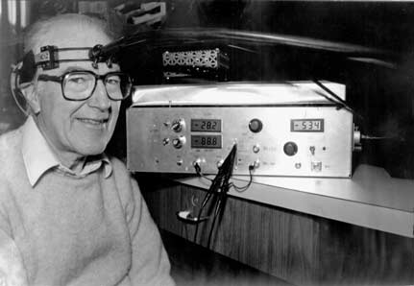
The stopped-flow method and chemical intermediates in enzyme
reactions – a personal essay
Britton Chance
Photosynthesis Research 80: 387–400, 2004.
Fig9

Slide 19
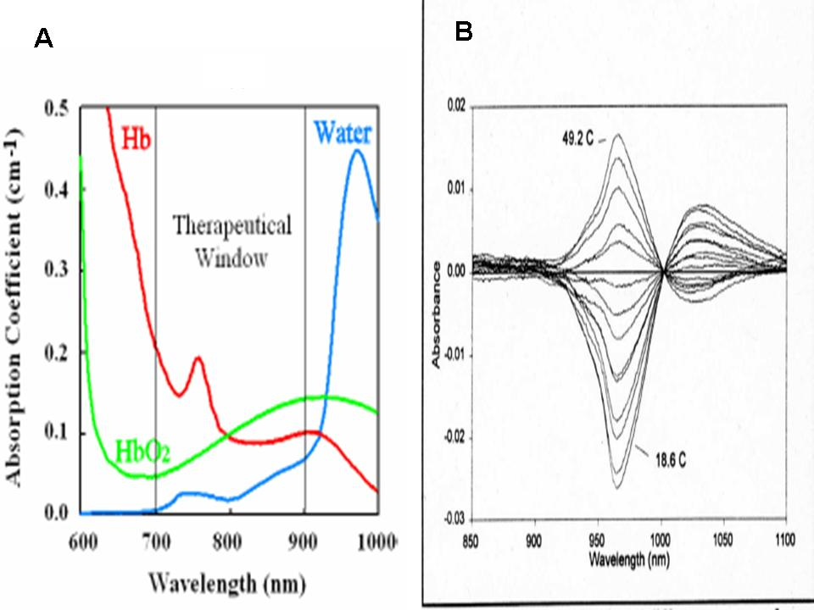
Chance proposed that opening of the mPTP might be visible by NIR providing a diagnotic tool
to diagnoses TBI and evaluate treatment
Fig. 3A. Illustration of a merging of the hemoglobin and water absorption spectra to an arbitrary scale to show their spectral overlap and the optimal “windows for minimal crosstalk of the three metrics to be studied. Fig. 3B. Sensitivity of water absorption spectrum to temperature. Thermal difference spectra of water in a 1 mm path length, baseline 37º with lowering to 17 º and rising to 50 º, showing that 970 nm is an appropriate measuring wavelength and 1010 nm is a suitable reference wavelength. A signal increment of 0.010 optical density per degree for a 1 cm optical path is calculated | .

Slide 20
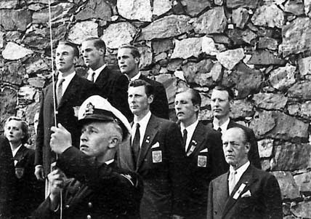
The stopped-flow method and chemical intermediates in enzyme
reactions – a personal essay
Britton Chance
Photosynthesis Research 80: 387–400, 2004.
Fig9

