Slide 1
Laszlo Gyulai
University of Pennsylvania
Early development of in vivo NMR spectroscopy and simultaneous NAD/NADH fluorometry at the Johnson Research Foundation: how Brit's science and humanity changed my life

Slide 2
The Hungarian Connection of BC
The Experimental Research Department Of the
Semmelweis Medical University, Budapest Hungary
1970-s and 1980-s
Dr. Arisztid G. B. Kovach
Dr. Eors Dora
Dr. Laszlo Ligeti ( Laci 1)
Dr. Laszlo Szabo ( Laci 3)
Dr. Janos Hamar

Slide 3
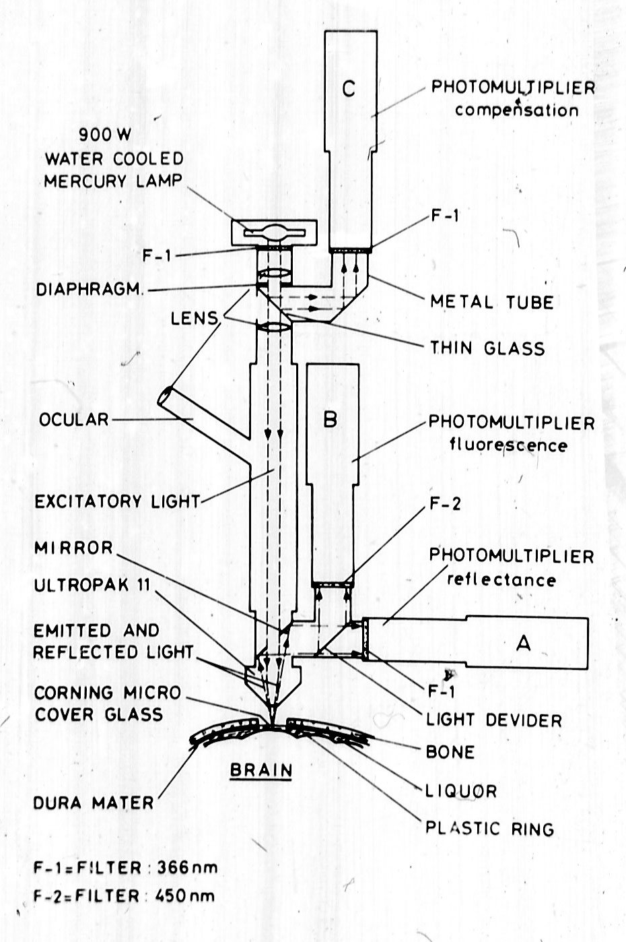
Brit’s Fluorometer in
Budapest
We were excited about studying mitochondrial function IN VIVO !!
My dream became of working with Brit in Philadelphia .

Slide 4
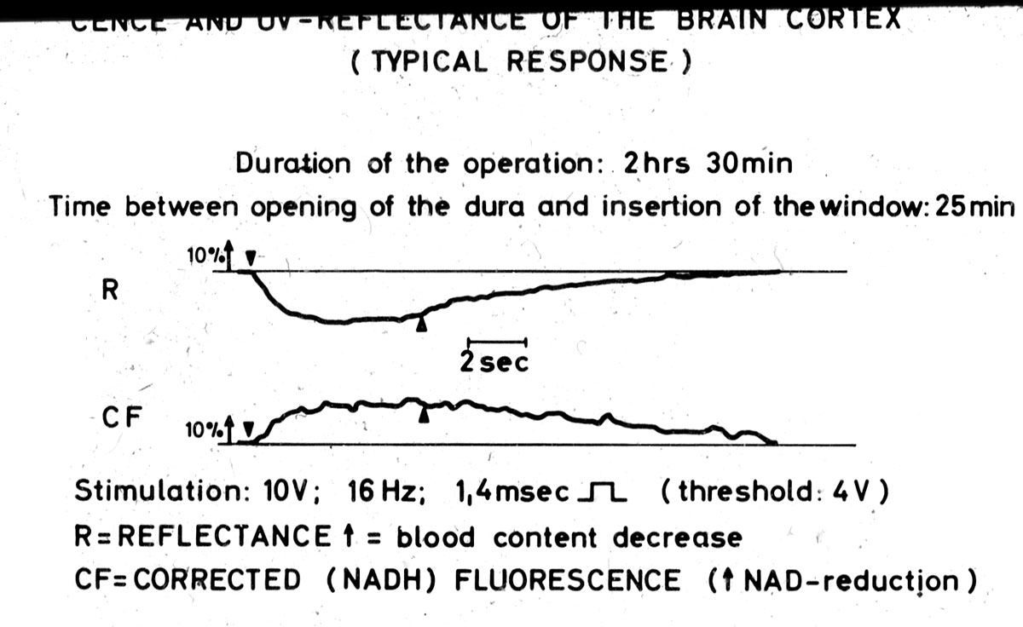
Increase in CF f(NADH) during electrical stimulation of the brain cortex created intense scientific debate
What is the correction factor for changes in fluorescence when the local blood volume changes ?

Slide 5
I became Laci 2
Arriving to Philadelphia in October 1980 from Budapest
Laszlo Ligeti ( Laci 1) picked me up at the airport and took me directly to a Phillies game where I met with Clyde Barlow, John and Brigitte Haselgrove, Terry Frey ( ? Jack Leigh?), Allen Bonner and others ( forgive me if I left somebody out).
Laci 1 had been working at the JF –he was my guide to Brit’s World and the US

Slide 6
Personal Turning Point
I started working on low temperature 2D fluorometry under Brit’s guidance at Martin Reivich’s lab (CVRC).
I became ill by December 1980.
I had extended treatment for 6 months
Eternal gratitude goes to Drs. Peter Cassileth and Robert Goodman and HUP.

Slide 7
Brit’s reaction
“Laci , you just take care of yourself and when you are well enough just show up for work at the JF “
( paraphrased).
In the summer of 1981 I returned to the JF very thin but eager
Brit: “Laci, you may want to work with Avraham Mayevsky”.
Avraham and I determined the correction factor for hemodynamic artifact in UV fluoro-reflectometry in rats by injecting saline in the brachial artery of rats and monitoring UV reflectance and NADH fluorescence in the brain.

Slide 8
Brit and Jack Leigh
Jack told Brit on a Friday night that he was smartest among us.
Jack genius and generosity was also unparalleled.
My work was always guided by both of these great and very different men.
Brit was like a father for me.
Jack was like my older brother .

Slide 9
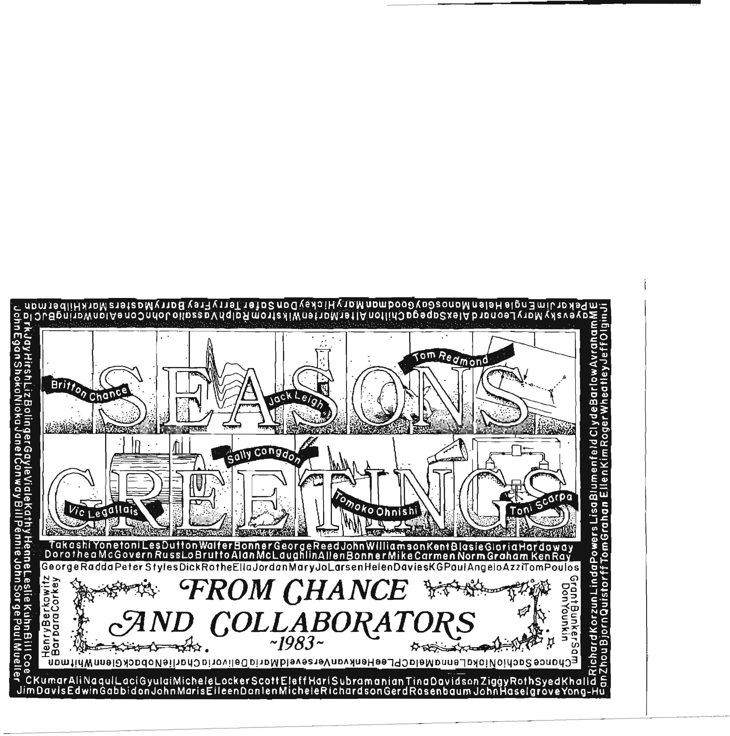
My “family” in the USA
Also the Mechanick Family: Jerry, Leah, Judy, Steve and Andrea

Slide 10
Full steam ahead
As soon as I recovered my full strength, began my full JF work schedule and “living” at the JF
Under the guidance of Brit and Jack Leigh, our team (Clyde Barlow, John Haselgrove, Harihara Subramanian, Scott Eleff) tried to get the first ³¹ P NMR spectra of the cat brain in the 7” magnet.

Slide 11
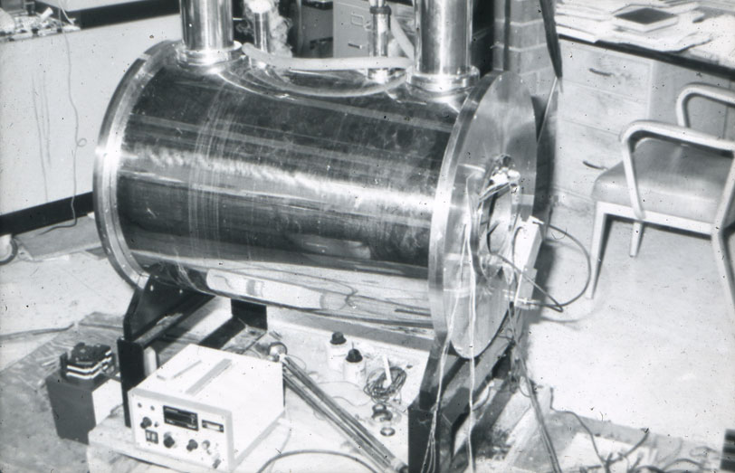

Slide 12
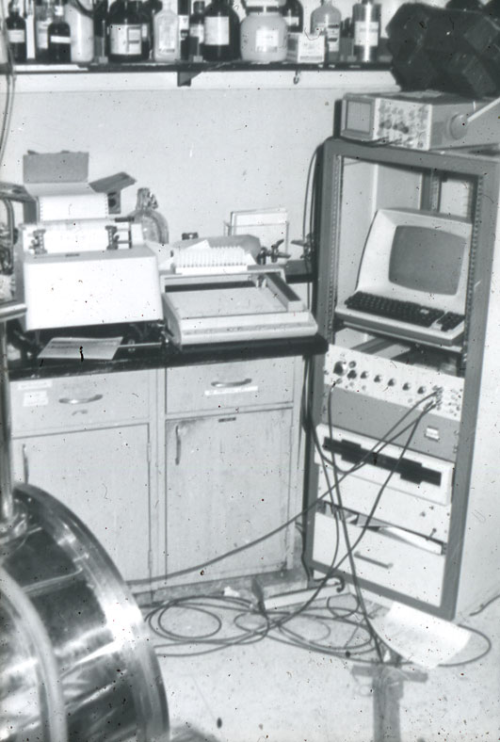

Slide 13
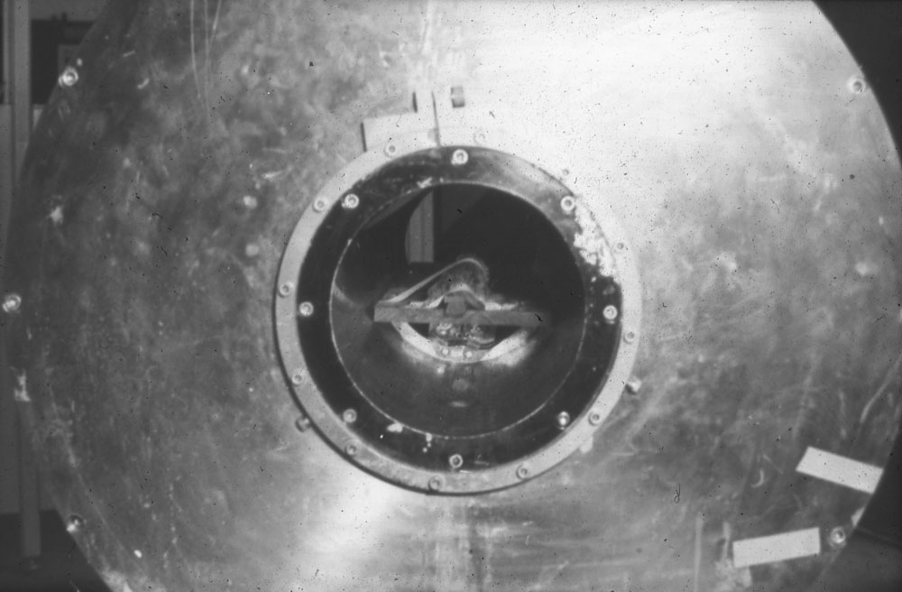

Slide 14
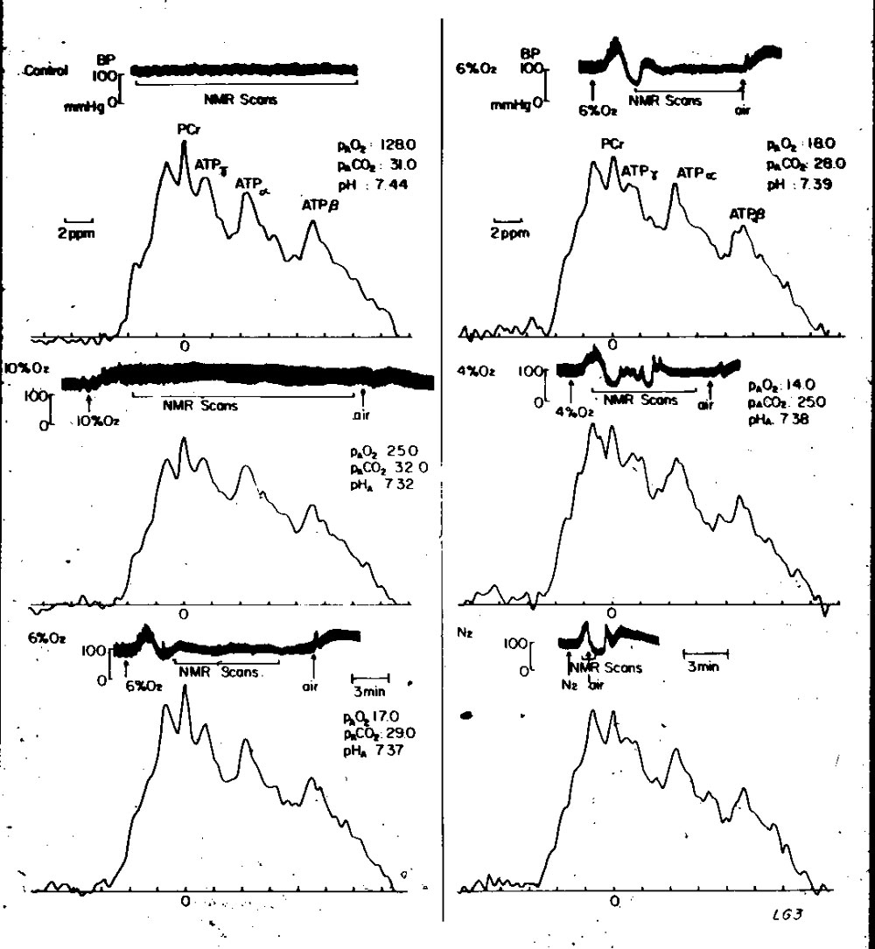
We were very happy to get these spectra!!!!

Slide 15
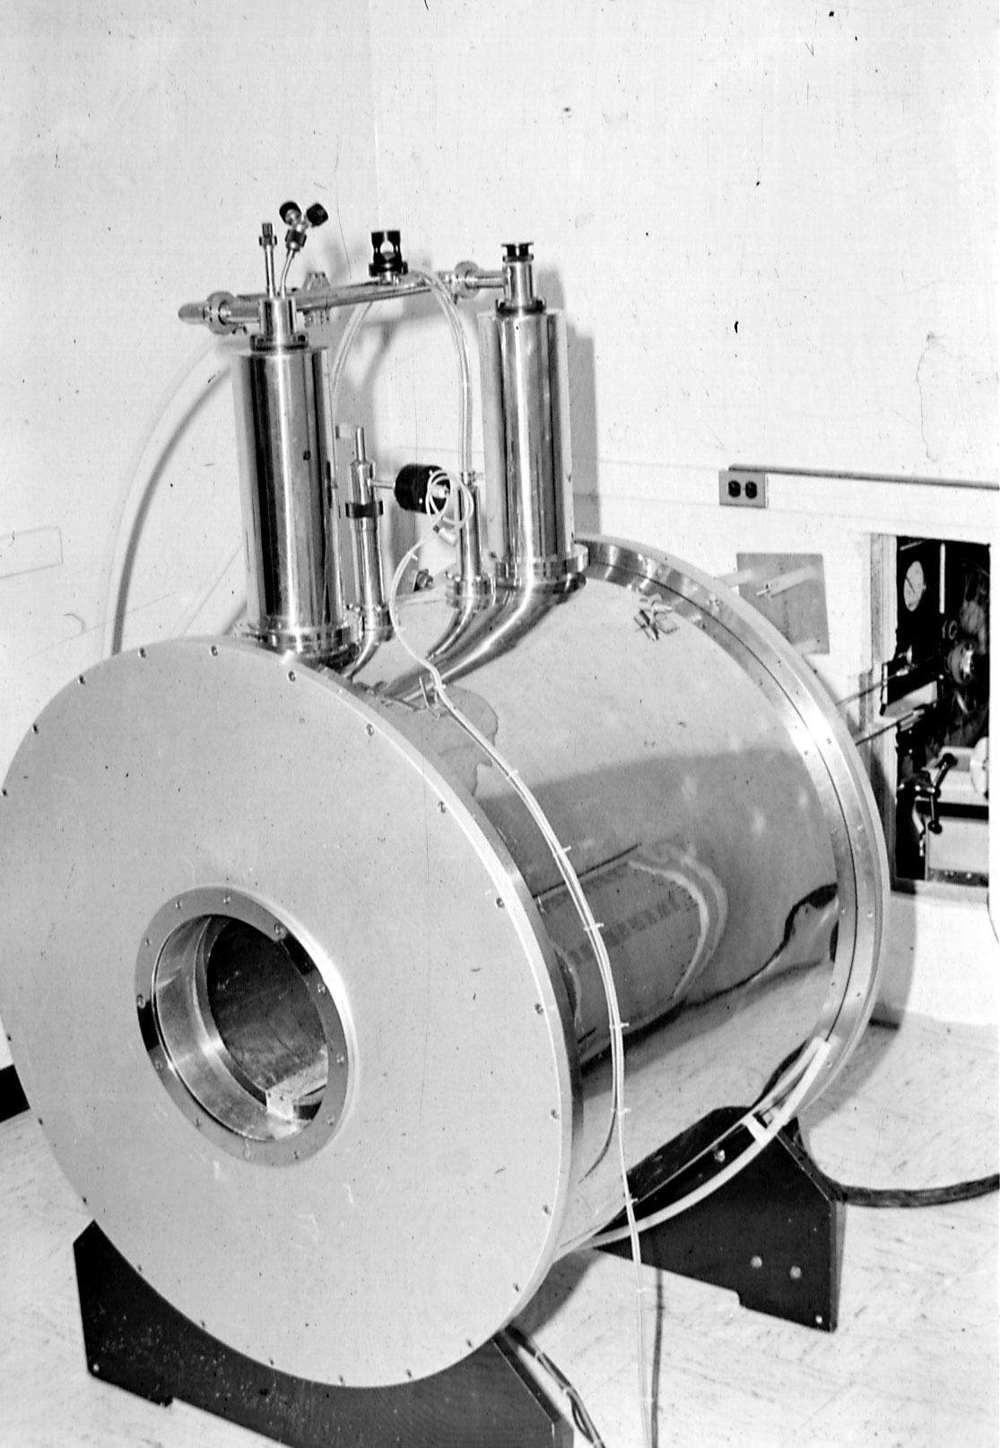
Scott Eleff and Harihara Subramanian used to stand programming the spectrometer ( that John Sorge put together ) for many many hours

Slide 16
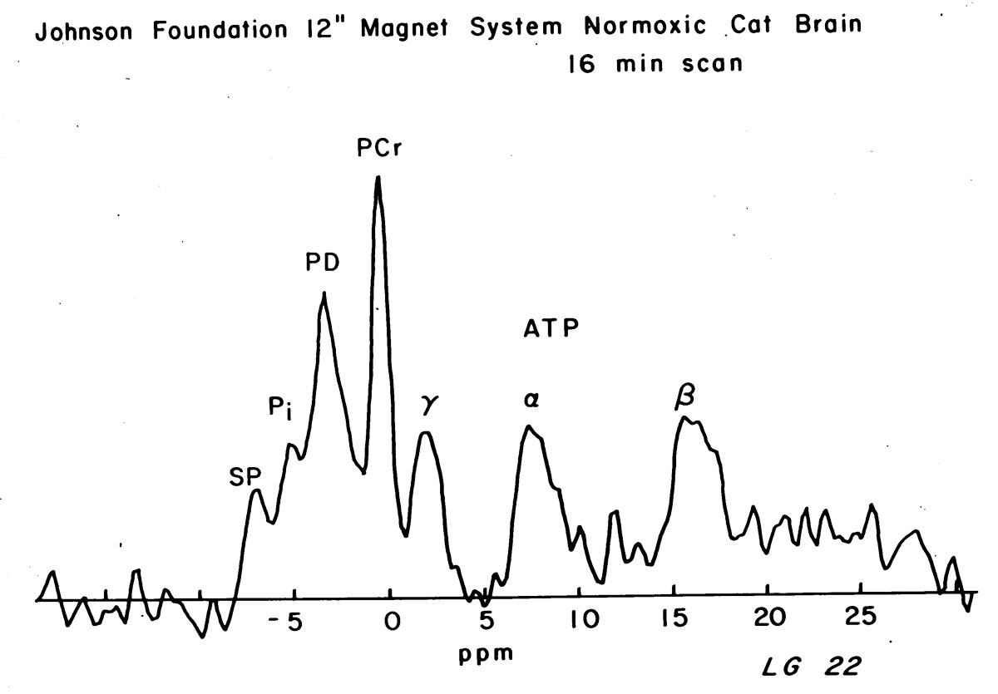

Slide 17
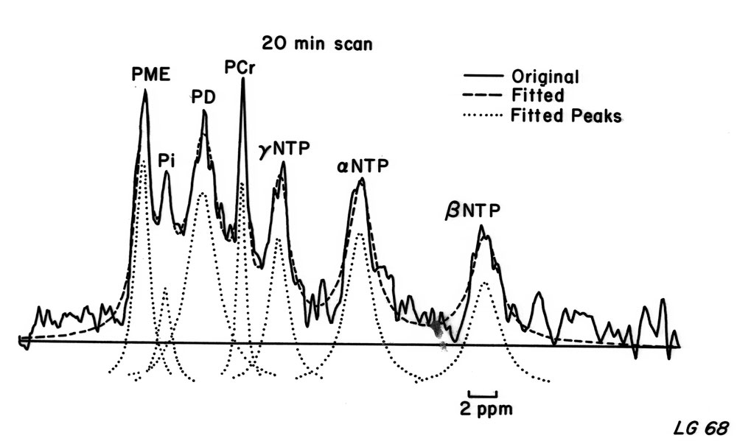
What makes up the PME peak ?
( curve fitting:
Harihara Subramanian, John Haselgrove )
Gyulai et al, FEBS ,178:137-142

Slide 18
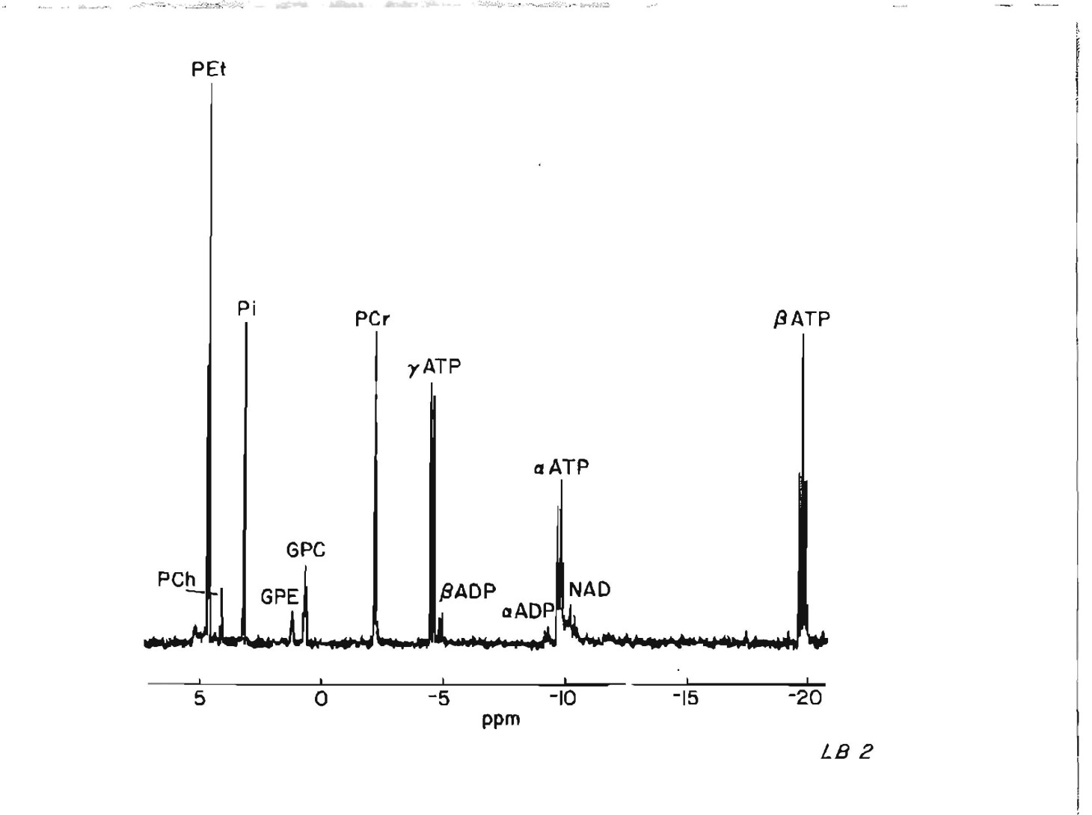
With Lizann Bolinger we determined that the major constituent of the PME peak was phosphorylethanolamine
Gyulai et al, FEBS ,178:137-142

Slide 19
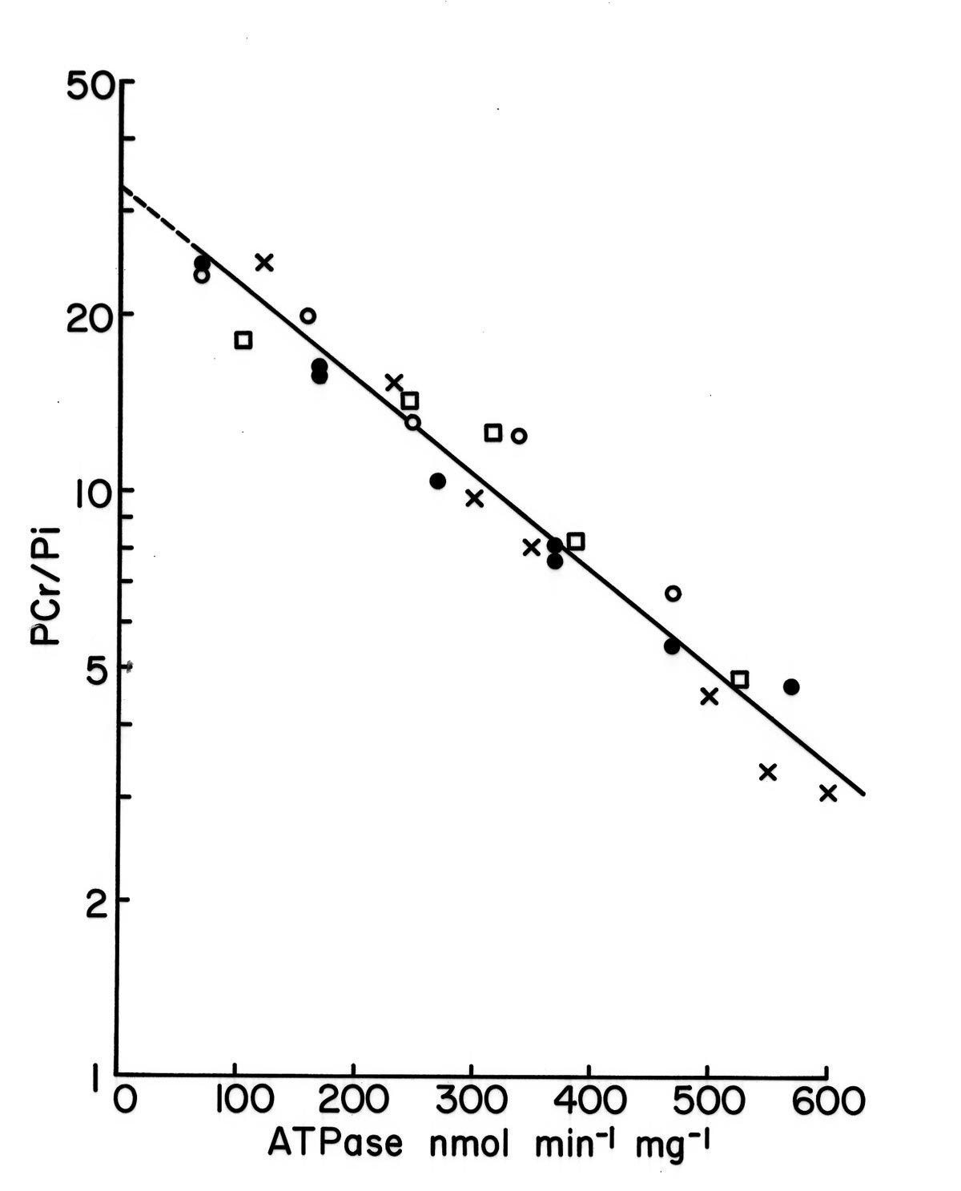
We studied the phospho-energetics of isolated mitochondria by NMR with Ziggy Roth
Gyulai et al, JBC, 260:3947-3954,1985

Slide 20
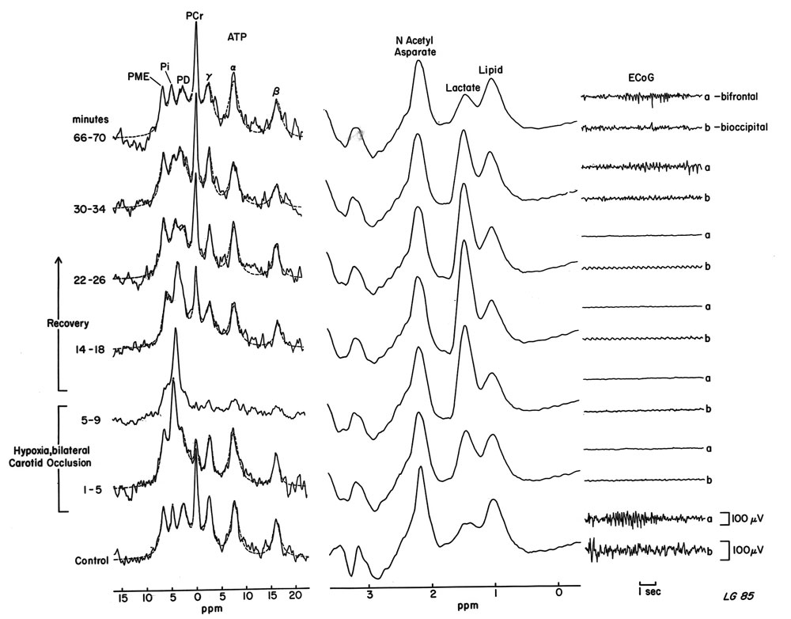
Mitch Schnall developed simultaneous ³¹P and ¹H NMR spectroscopy in vivo and he. Alan McLaughlin and I tested the new method in brain hypoxia
Gyulai et al, Journal Cerebral Blood Flow and Metabolism 7:543-551, 1987.

Slide 21
I proposed to Brit combining NAD/NADH Fluorometry with ³¹P NMR for the most complete characterization of brain mitochondrial function in vivo at that time in a hypoxia model
Brit said: “Laci that is very ambitious” but he supported the project and supervised it with great scrutiny.
Gyulai et al, American Journal Physiology 254:C699-C708, 1988.

Slide 22
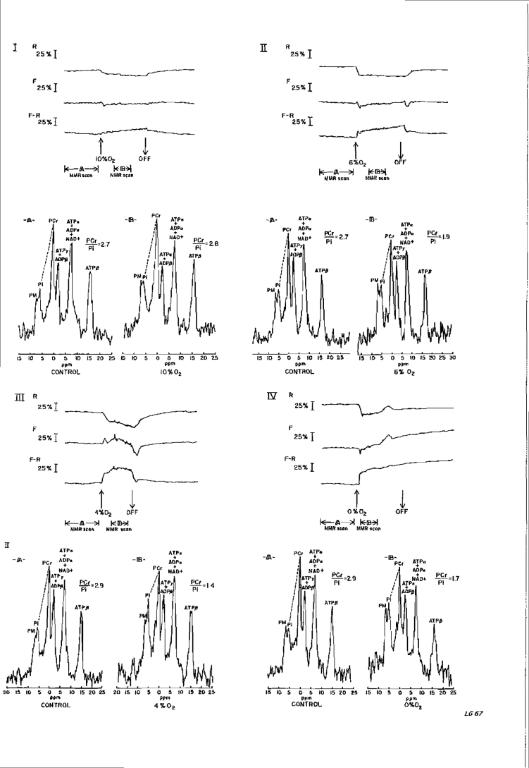
Success!
George McDonald ran the Bruker machines and taught me a lot.
Gyulai et al, American Journal Physiology 254:C699-C708, 1988.

Slide 23
The results
Gyulai et al, American Journal Physiology 254:C699-C708, 1988.

Slide 24
The results
At 6% FiO2 and at 50 % NAD reduction
phosphorylation ratio dropped.
Gyulai et al, American Journal Physiology 254:C699-C708, 1988.

Slide 25
1985: I decided to become a psychiatrist
I felt that all the help that I received from Brit, my friends at the JF and a Penn psychiatrist , Jerry Mechanick plus all I learned about myself needed to be translated into my helping the sick in a direct way .
I felt NMR was ready for human use and hoped to continue my NMR research in a new field.
I was determined to use quantitative methods in the research of bipolar disorder
I was committed to using Brit’s rigor of hypothesis testing in my clinical practice and avoid “ sloppy science”
I was also committed to use my newly discovered empathy for treating suffering human beings in integrated with the scientific method

Slide 26
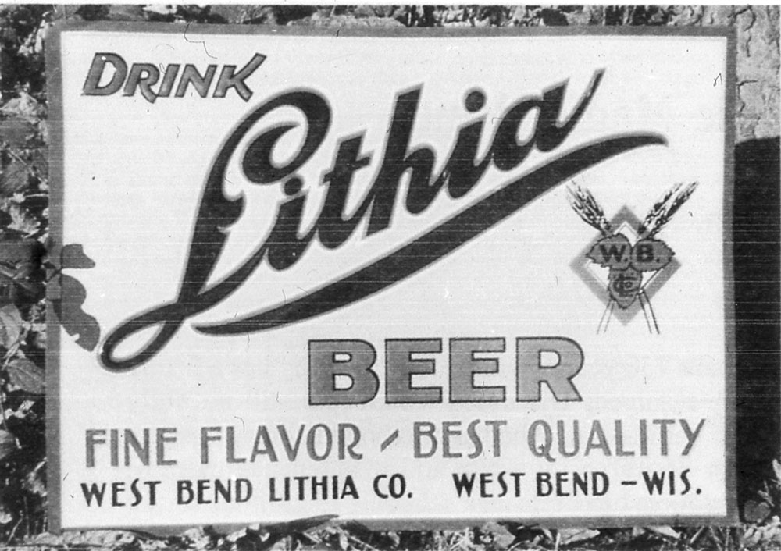

Slide 27
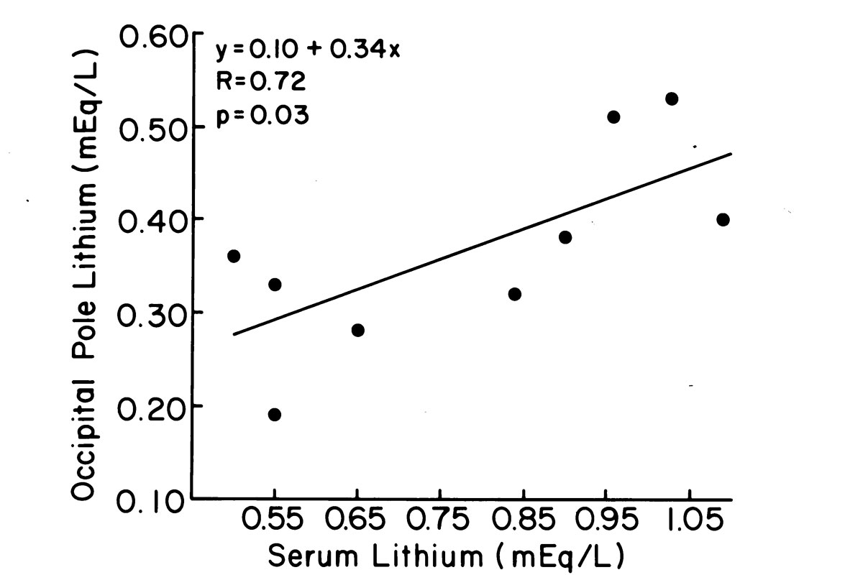
In the Pool with Jack and Steve Wicklund
Gyulai et al, Biological Psychiatry 29:1161-1170, 1991.

Slide 28
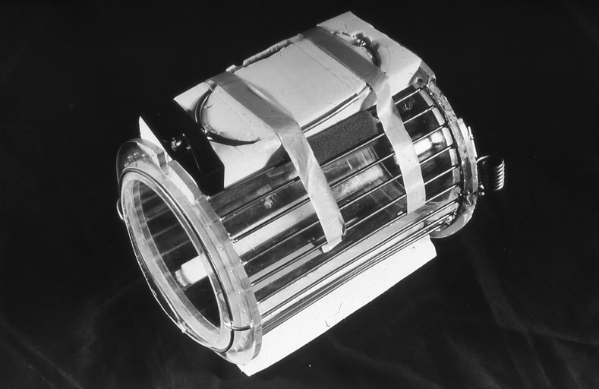
Bob Lenkinski and Gabor Mizsei designed and built the proton /lithium volume coil

Slide 29
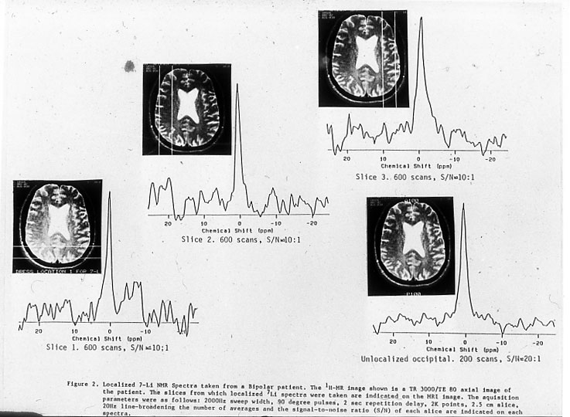

Slide 30
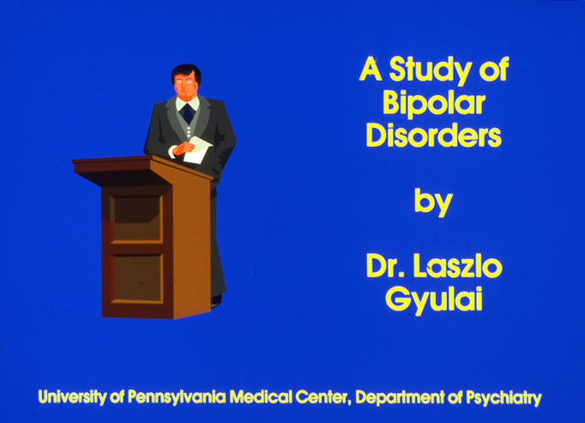

Slide 31
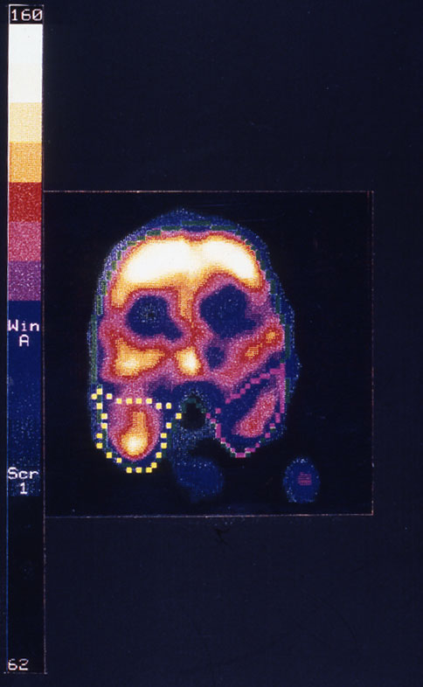
SPECT Blood Flow Measurement in Patients with Bipolar Disorder with Abass Alavi
Gyulai et al, Biological Psychiatry
41:152-161, 1997.

Slide 32
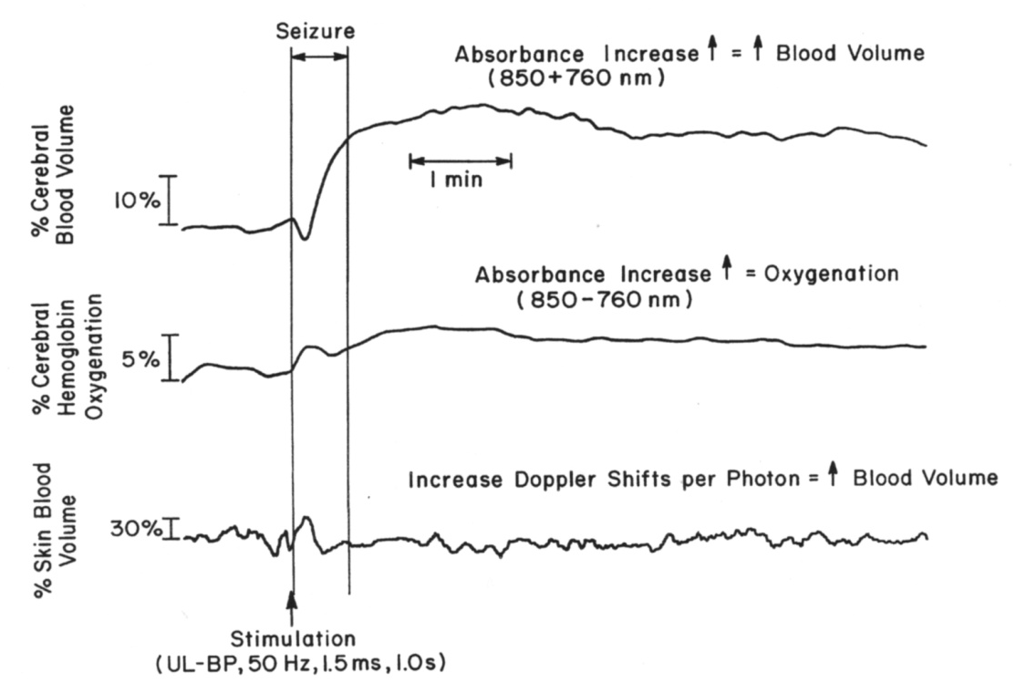
Near Infrared Measurement of Blood Volume and Hb oxygenation during electroconvulsive therapy
Working with BC again was a joy
Back to brain stimulation

Slide 33
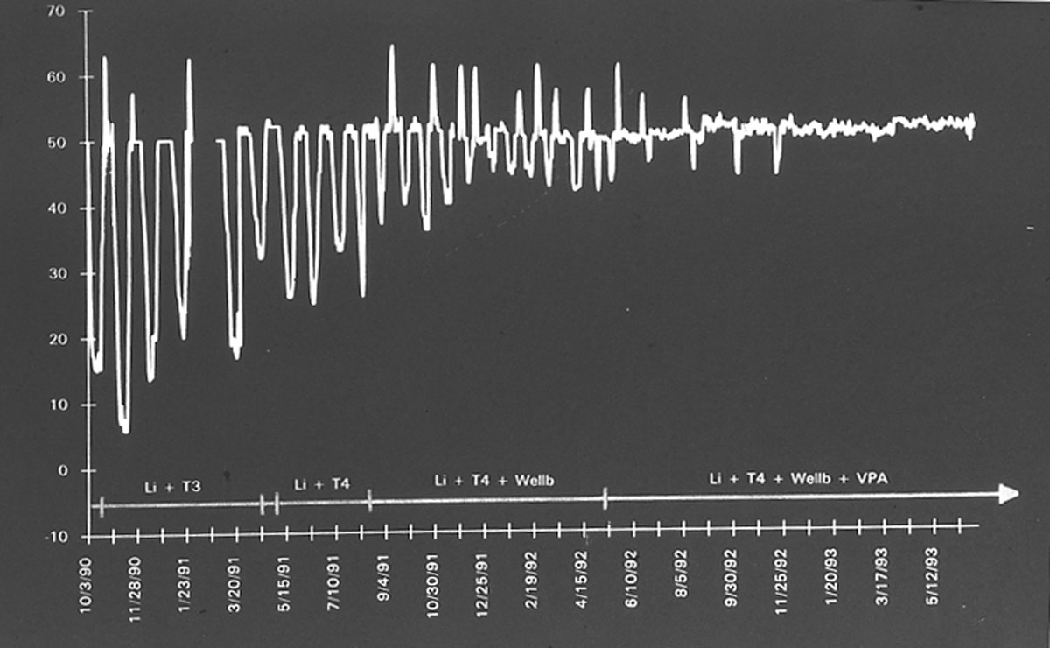

Slide 34
In collaboration with others we have developed computerized self reporting of daily mood fluctuations mathematical modeling is in progress

Slide 35
Brit’s legacy in psychiatric research
Published papers in psychiatry using Magnetic Resonance Spectroscopy:
Major Depression: 64
Bipolar disorder: 217
Schizophrenia: 351
BC ‘s and Jack Leigh’s mentorship started Perry Renshaw’s career who as of now published appr. 117 papers on MRS in various psychiatric conditions.
In Japan Toshiro Inubushi has been instrumental of use of MRS in psychiatric research.

Slide 36
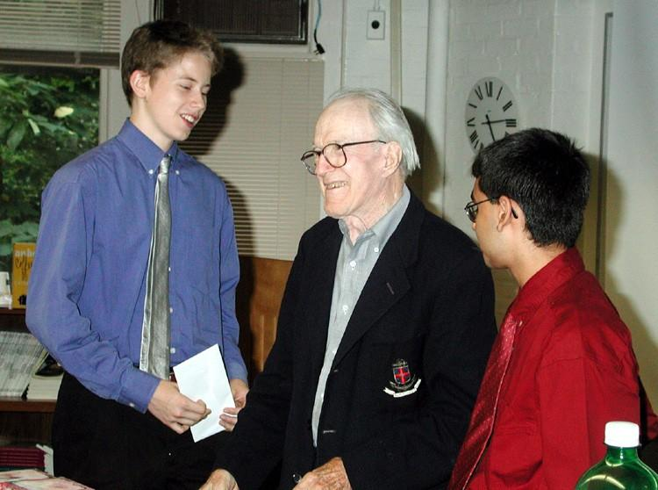
My son in the summer science program getting a prize from BC and Shoko

Slide 37
Brit respected my clinical work
“ Laci, Your work with us at the JF must have been useful in your clinical work”
He, as usual, was right on target, succinctly and with great insight

Slide 38
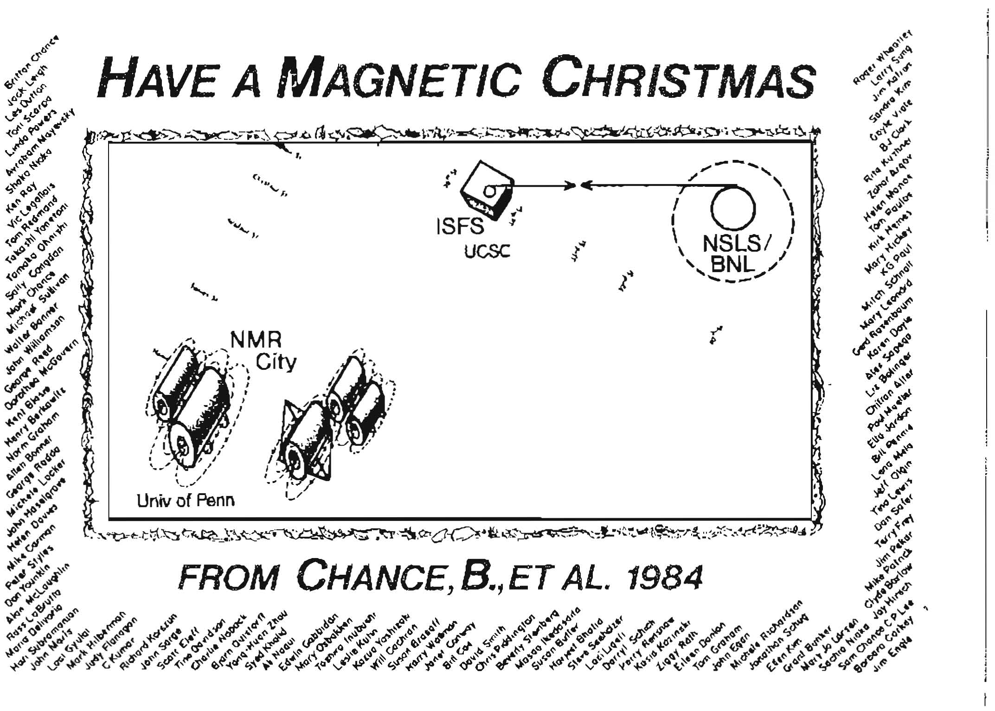
Thank you friends!

