Slide 1
First Discovery of NIR Response of Brain Activation and Development to Present Status
Yoko Hoshi
Integrated Neuroscience Research Project
Tokyo Metropolitan Institute of Medical Science
Workshop in Memory of Prof. Britton Chance 2011/06/04

Slide 2
From NIRS to fNIRS
B. Chance, et al. “Cognition-activated low frequency modulation of light absorption in human brain,” Proc. Natl. Acad. Sci. USA 90, 3770-3774 (1993).
Y. Hoshi and M. Tamura, “Detection of dynamic changes in cerebral oxygenation coupled to neuronal function during mental work in man,” Neurosci. Lett. 150, 5-8 (1993).
T. Kato, et al. “Human visual cortical function during photic stimulation monitoring by means of near-infrared spectroscopy,” J. Cereb. Blood Flow Metab. 13, 516-520 (1993).
A. Villringer, et al. “Near-infrared spectroscopy (NIRS): a new tool to study hemodynamic changes during activation of brain function in human adults,” Neurosci. Lett. 154, 101-104 (1993).
CW, absorbance changes

Slide 3
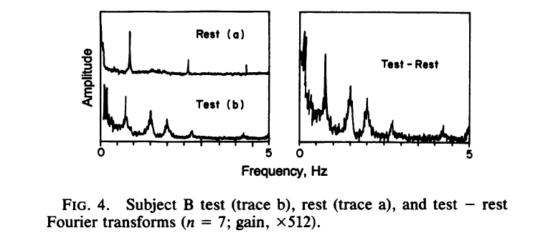
Frequency-domain (modulation at low frequency), changes in the low frequency components of the light absorption signal
Chance et al., Proc. Natl. Acad. Sci. USA 90, 3770-3774 (1993).

Slide 4
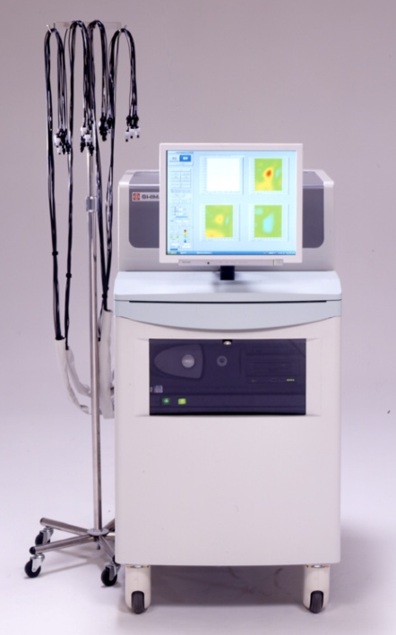
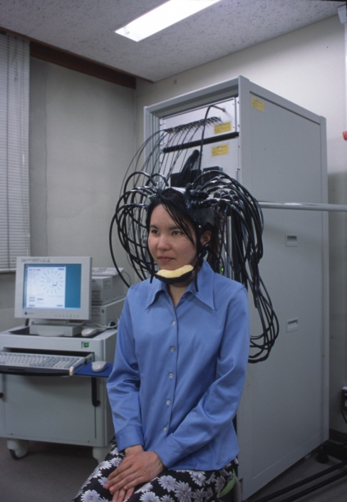
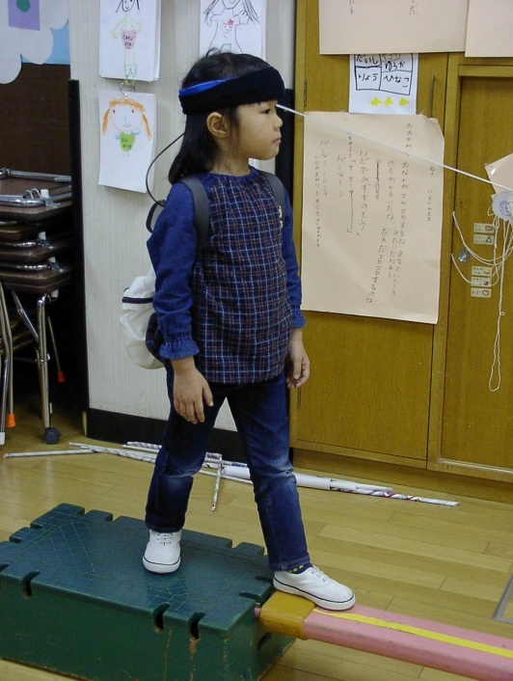
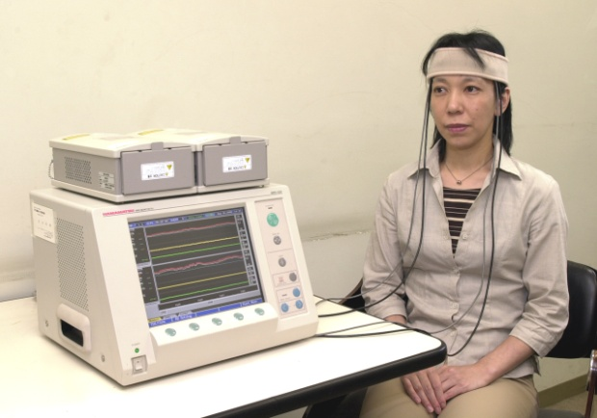
NIRS instruments
CW measurement system
TRS system
Wearable system

Slide 5
Compact and novel NIRS instruments
Luo Q, et al. Functional near-infrared imager. SPIE 2979, 84-93 (1997).
CW light imaging probe. Nine tungsten filament lamps and 4 dual wavelength silicon photodiodes are used for the image probe.
Chance B, et al. A novel method for fast imaging of brain function, non-invasively, with light. Opt. Exp. 2, 411-423, 1998.
A single wavelength phase array image system. Increases in sensitivity and spatial resolution.
Tian F., et al. Investigation of the prefrontal cortex in response to duration-variable anagram tasks using functional near-infrared spectroscopy. J. Biomed. Opt. 14, 054016, 2009.
A LED-based imager (LEDi).
A continuous wavelet transform algorithm is used to decompose and
examine the physiological noises.

Slide 6
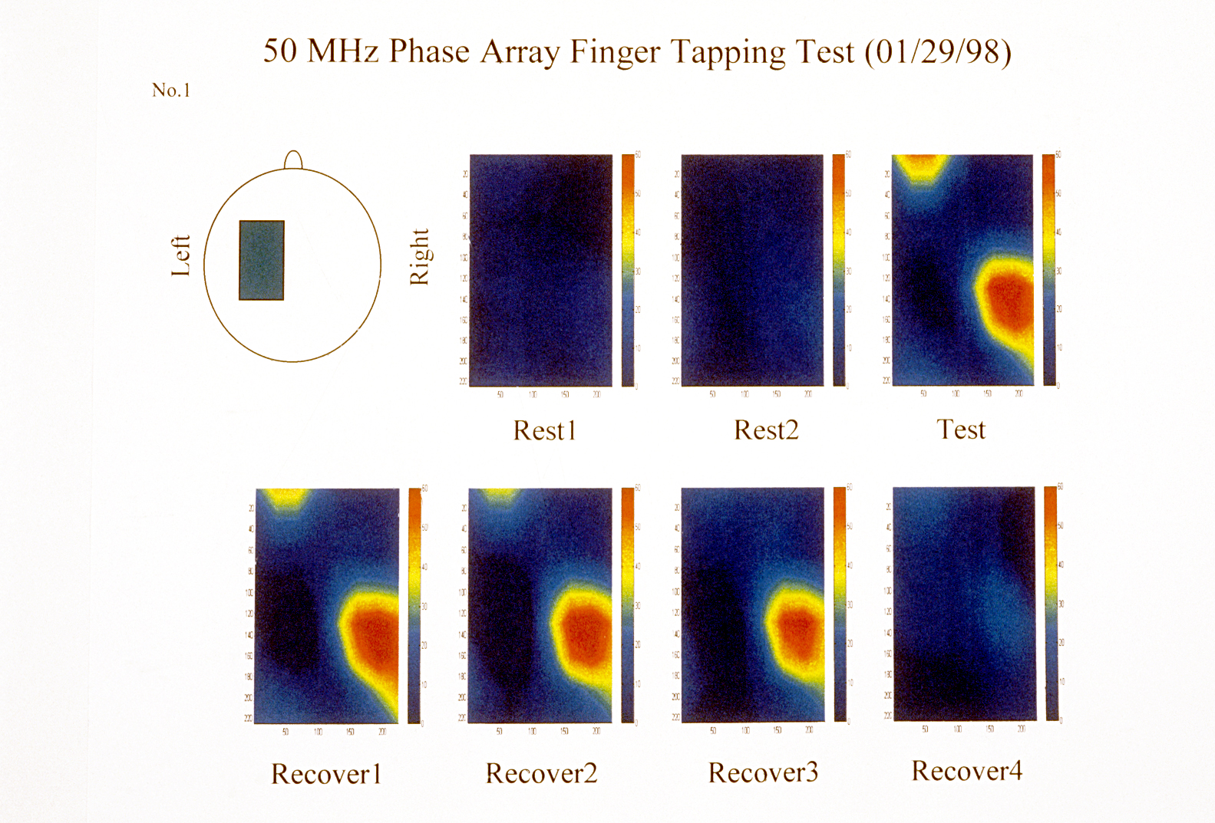

Slide 7
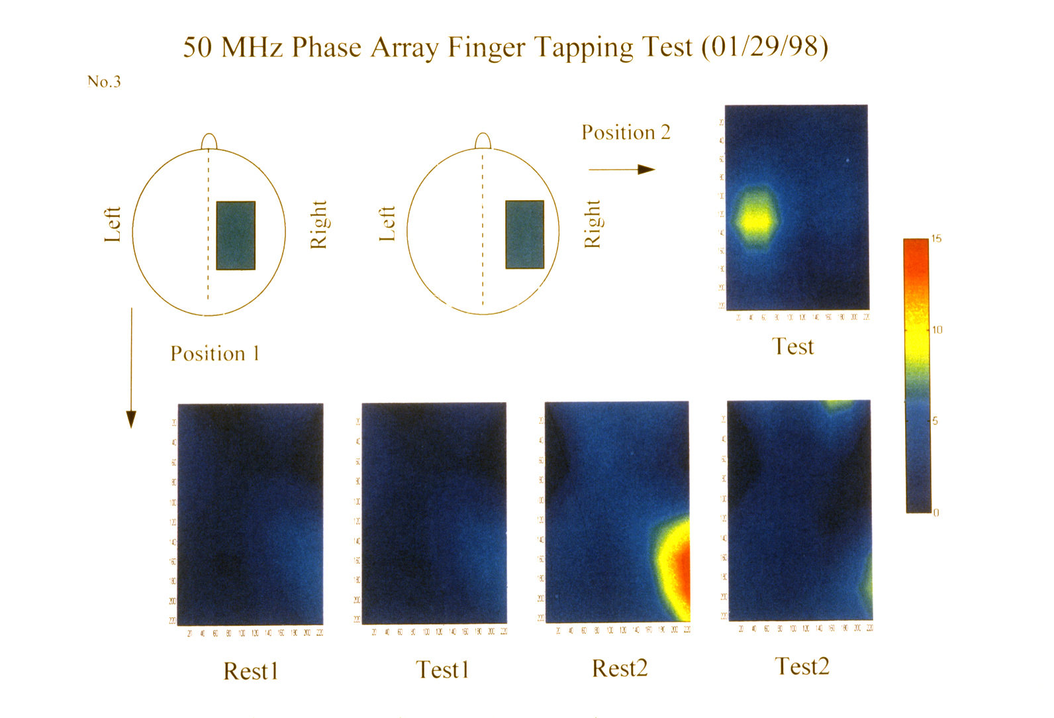

Slide 8
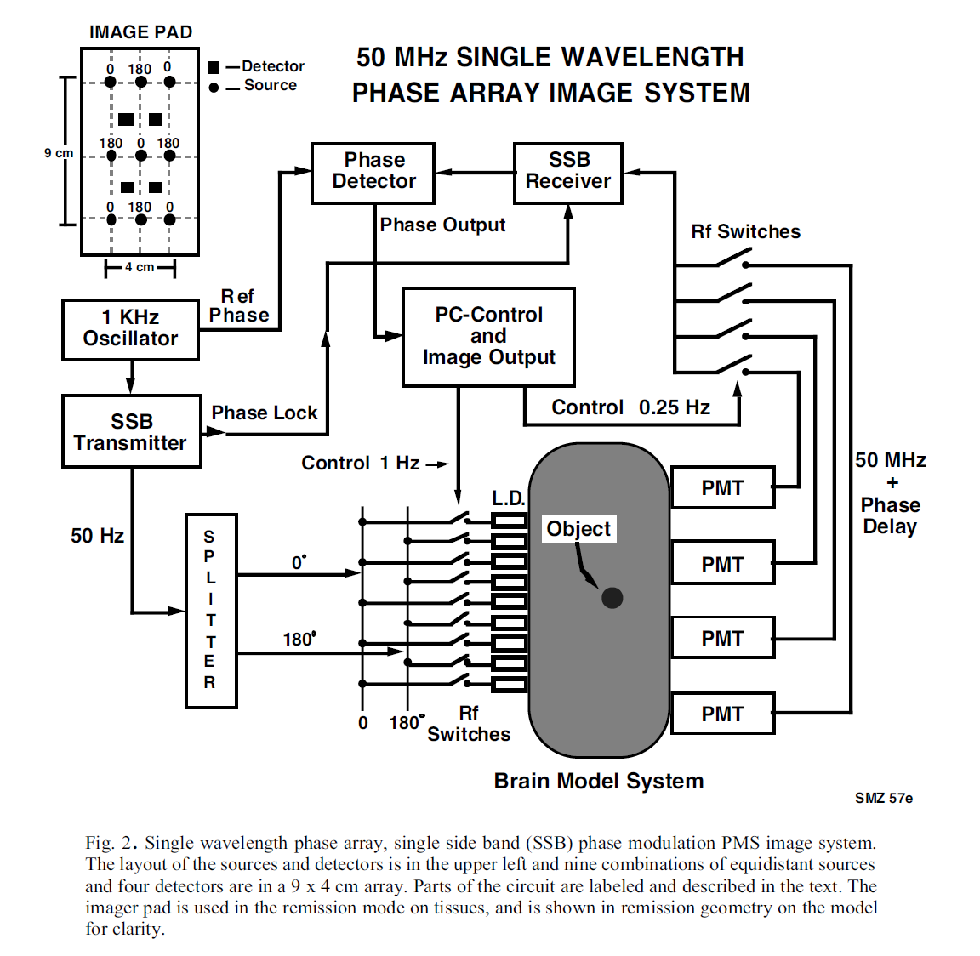
Chance et al. Opt. Exp. 2, 411-423, 1998

Slide 9
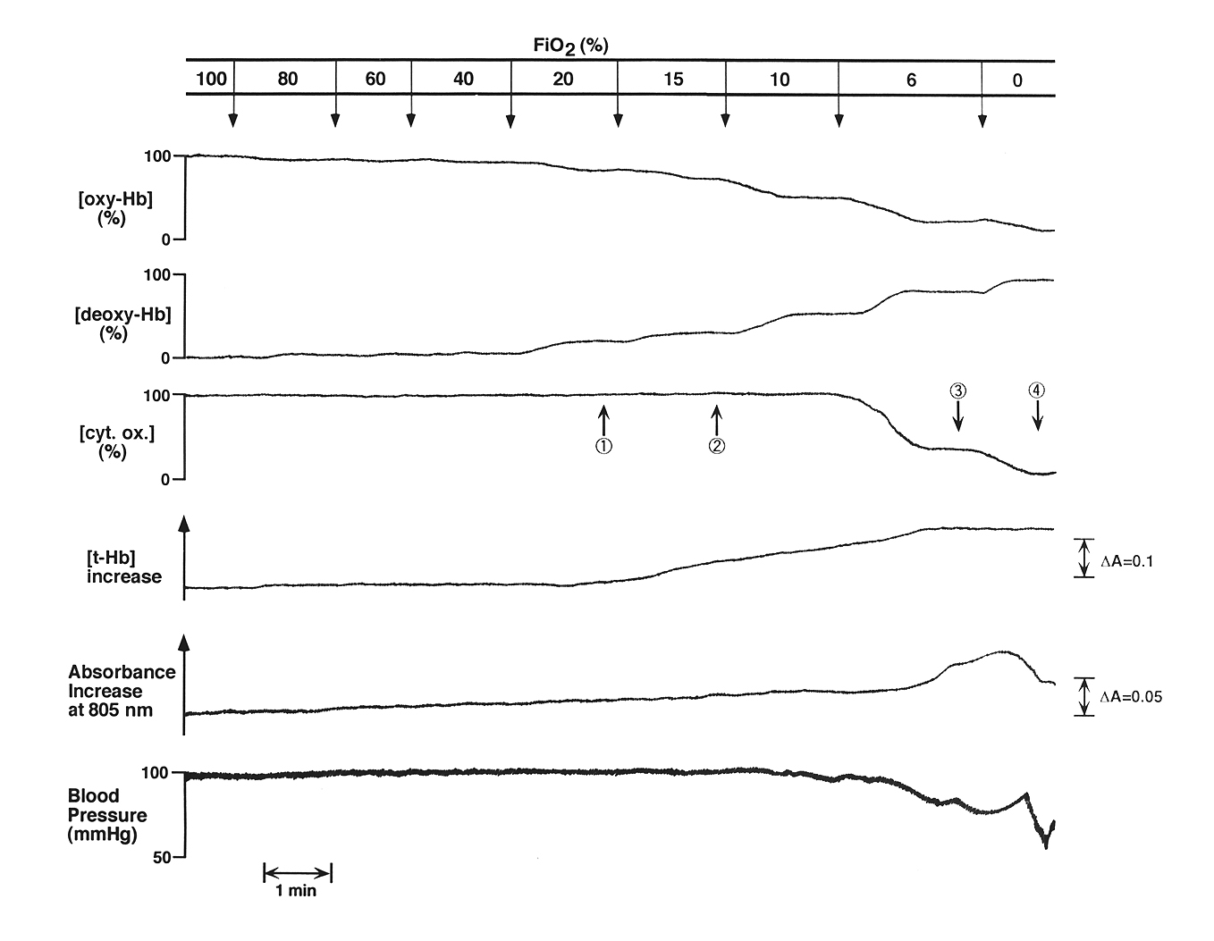
Reduction of cyt. ox. occurs only when oxygen supply is extremely impaired.
Hoshi et al. J. Appl. Physiol. 83, 1842-1845, 1997

Slide 10
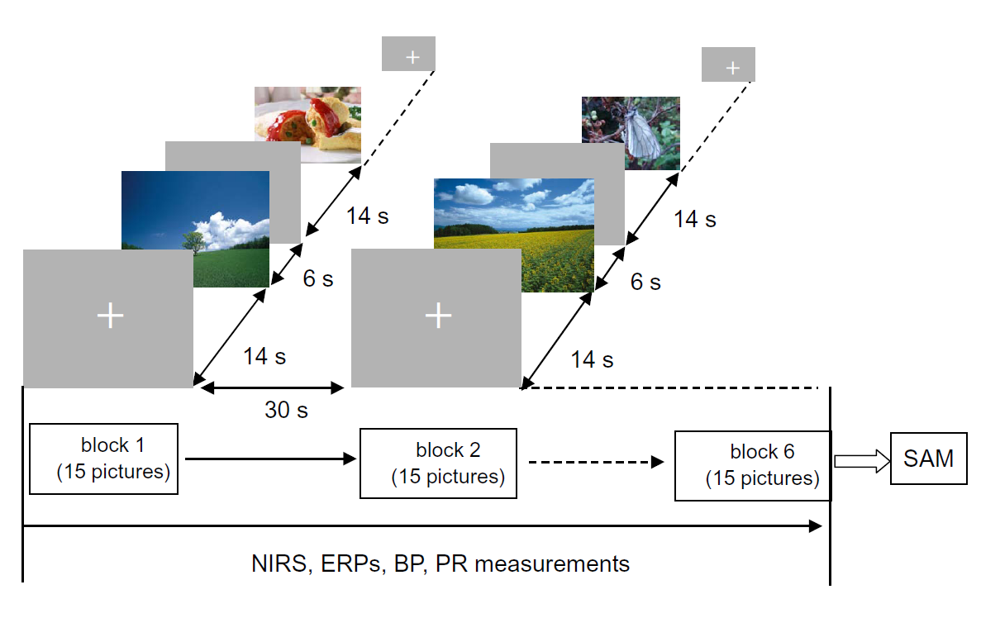
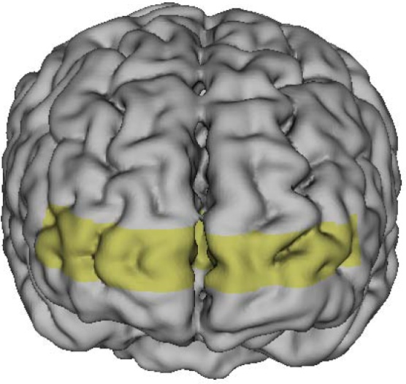
The role of prefrontal cortex in pleasant and unpleasant emotions.
RT
LT
“Mind/Brain –Human interface”
Hoshi et al. J Neuroimaging 2011

Slide 11
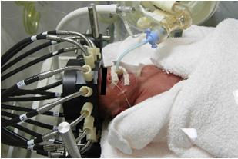
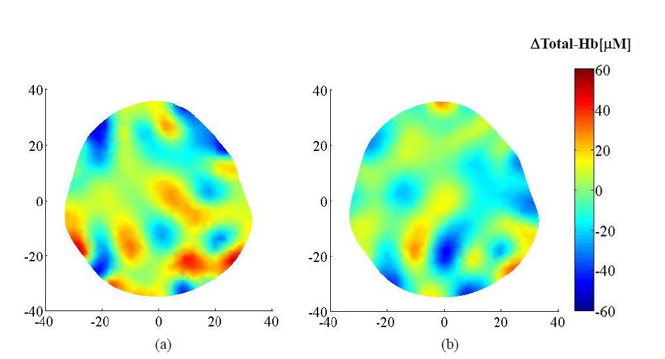
DOT in an extremely low birth weight infant
normocapnea
hypocapnea

Slide 12
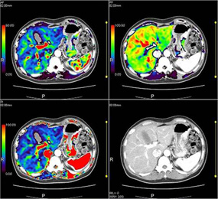
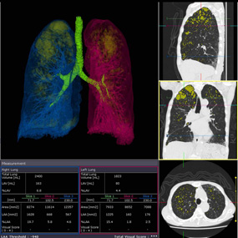
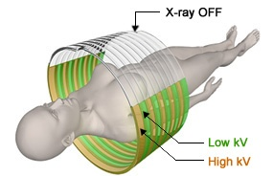
Dual Energy
Dual-energy helical scanning alternates between high and low kV with each gantry rotation. The mA is also automatically adjusted for the two different energies to ensure a matched signal to noise ration which increases the accuracy of dual energy analysis. In addition, Aquilion PRIME automatically turns X-ray exposure off as the X-ray tube passes the front of the patient, thus minimizing exposure to radiosensitive organs such as the breasts and eye lens.
Body Perfusion
Lung Volume Analysis
Dual Energy

Slide 13
I am greatly indebted to the profound pioneering research of Professor Britton Chance and I would like to pay him all due respects.

