Slide 1
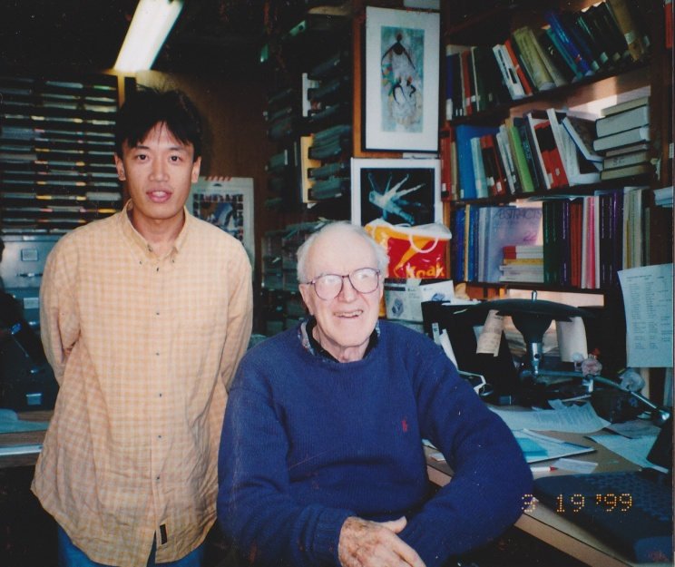

Lab. for Applied Physiology
University of Tokushima
Application of NIRS to Measure
Muscle Metabolism and Vessel Function
H Miura Ph.D.

Slide 2
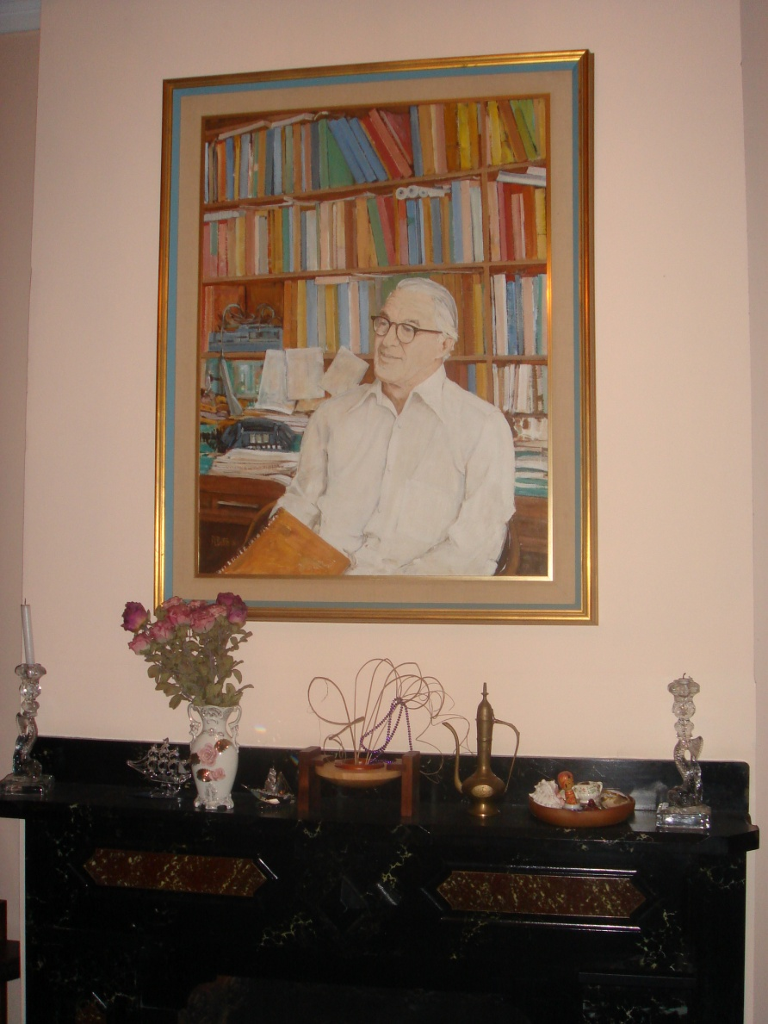
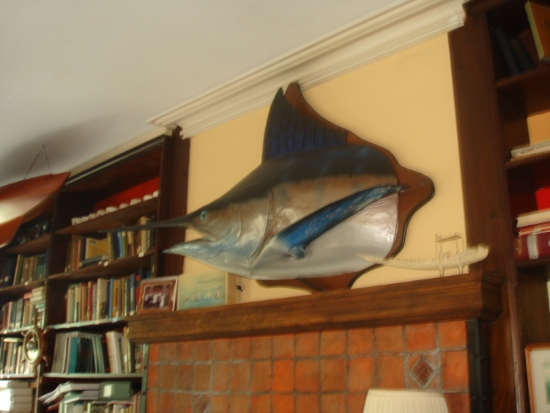
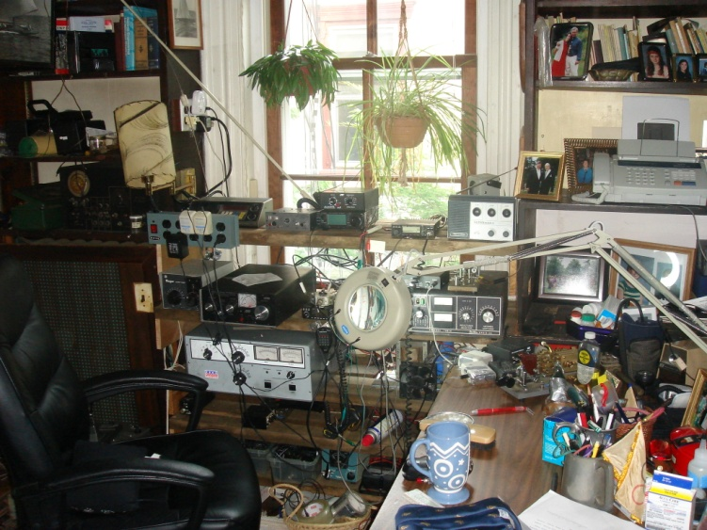
First encounter

Slide 3
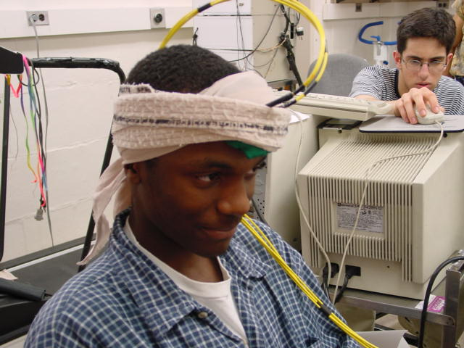
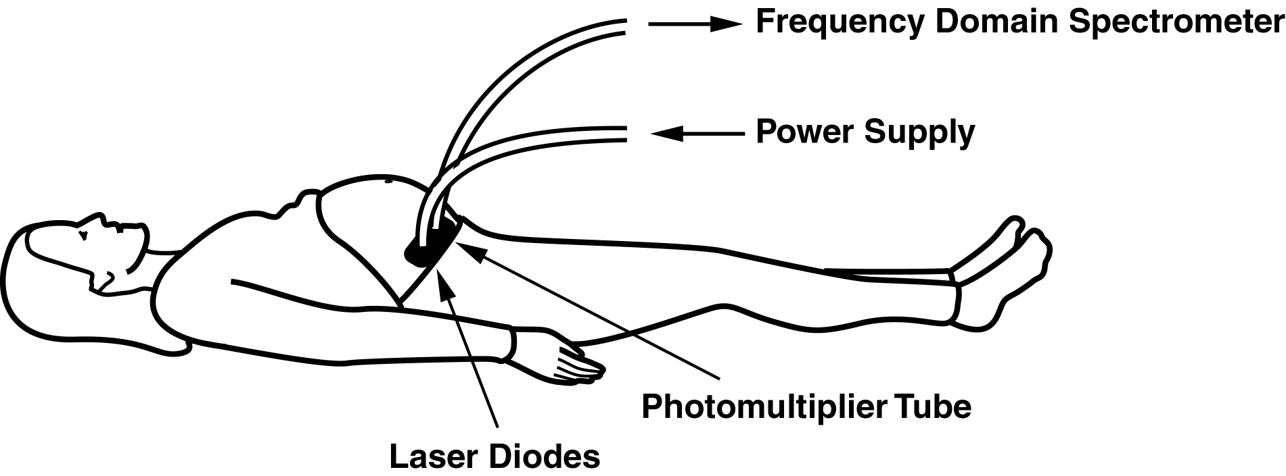
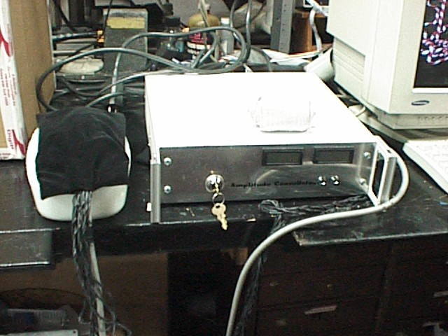
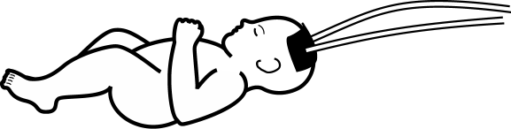
’98 ~ ’99 at BC’s Lab.
1) Brain function
2) Cancer detection
3) Muscle metabolism
4) Cesarean detection
5) Developing device
etc

Slide 4
Diagram for functional NIR imager
Sensor
light source
●
■
photodetector
Amplifier
A/D Board
Amplifier
A/D
Board
Lamp
Controller
Lamp
Controller
Miura et al. Jpn J Phys Fitness Sports Med 2000

Slide 5
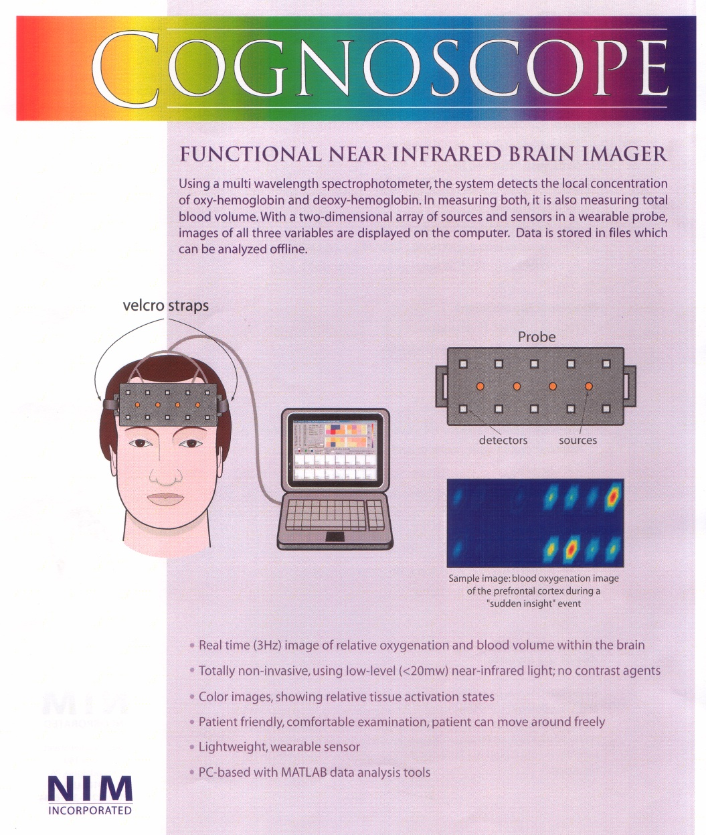
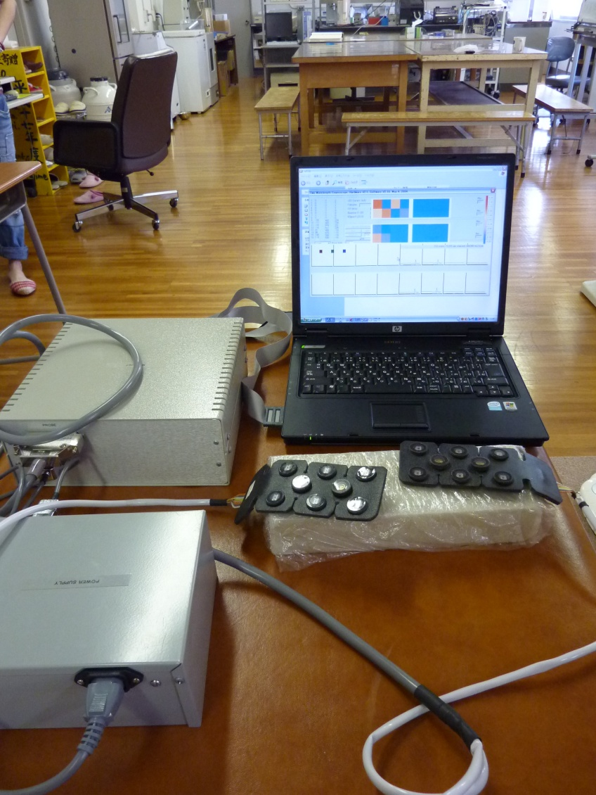
COGNOSCOPE NIM INCORPORATED

Slide 6
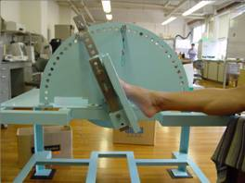
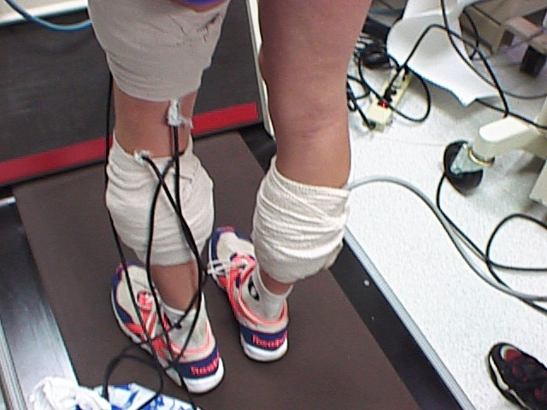
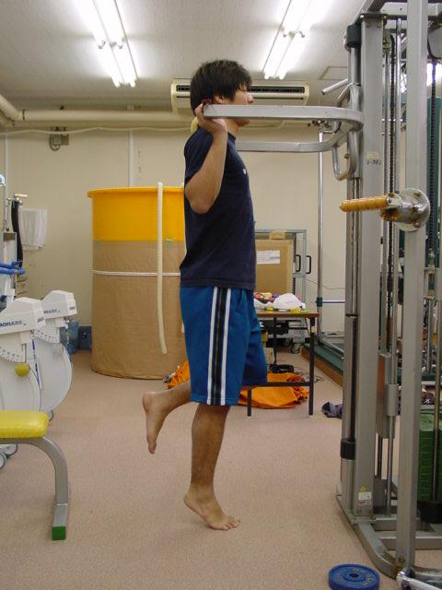
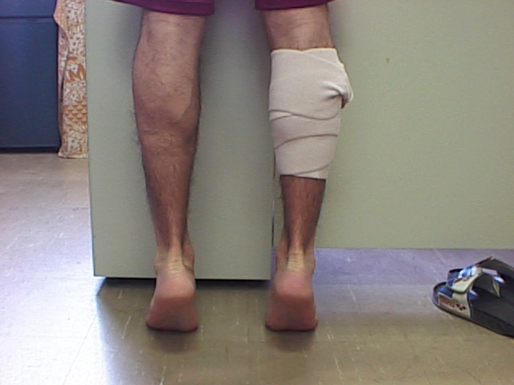
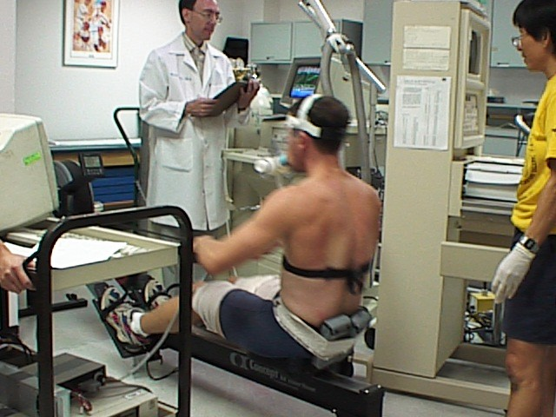
Measurement of muscle metabolism by functional NIR imaging device

Slide 7
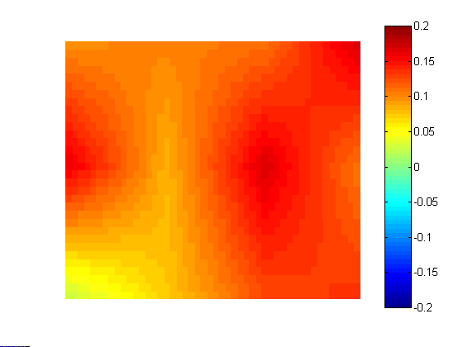
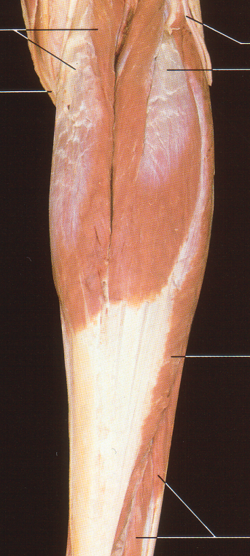
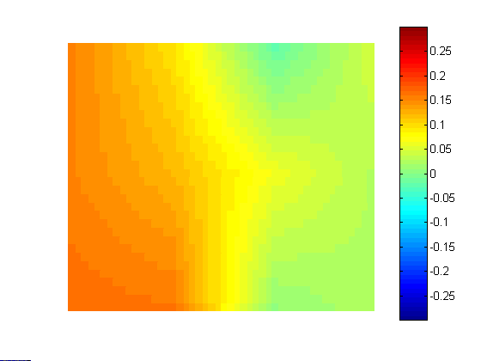
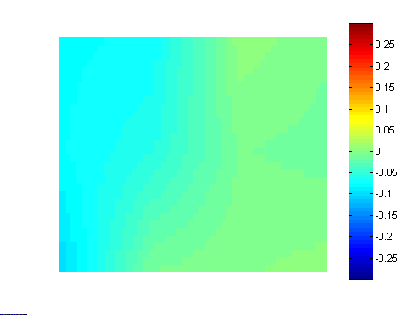
Oxygen saturation during standing plantar flexion in gastrocnemius muscle
(o.d.)
0.2
0.0
-0.2
deoxygenation
Rest
oxygenation
0.2
0.0
-0.2
deoxygenation
Exercise
oxygenation
0.2
0.0
-0.2
deoxygenation
Recovery
Right Leg
oxygenation
Miura et al. Jpn J Phys Fitness Sports Med 2000

Slide 8
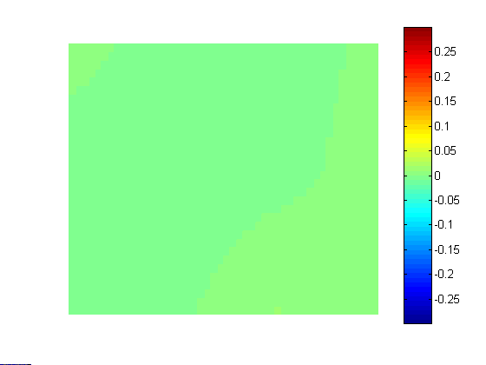
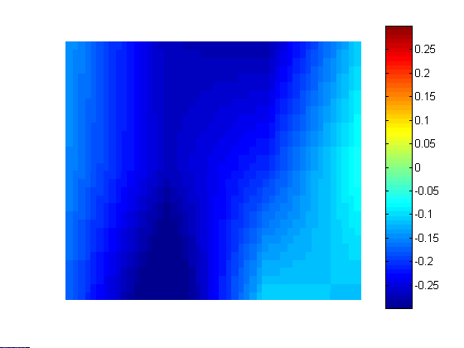
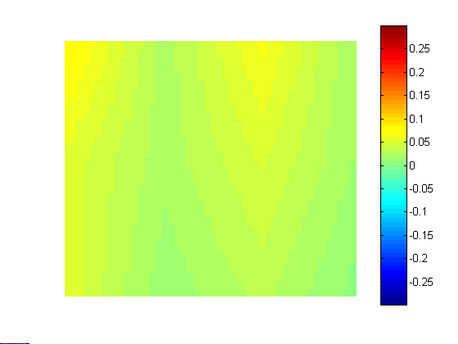
Blood volume during standing plantar flexion in gastrocnemius muscle
(o.d.)
0.2
0.0
-0.2
increase
Rest
decrease
0.2
0.0
-0.2
increase
Exercise
decrease
0.2
0.0
-0.2
increase
Recovery
Right Leg
decrease
Miura et al. Jpn J Phys Fitness Sports Med 2000

Slide 9
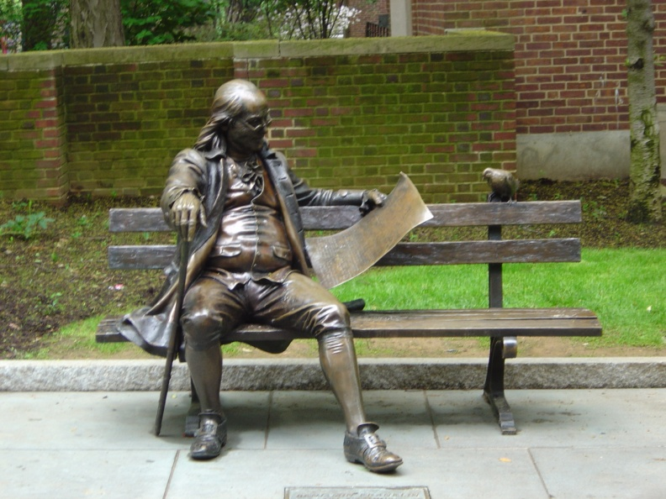
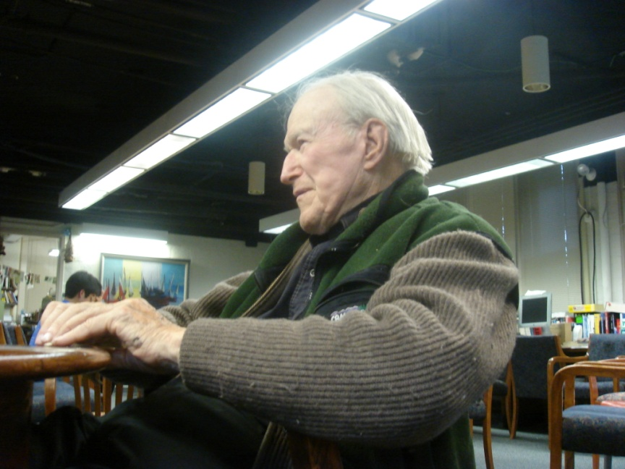
What’s next?

Slide 10
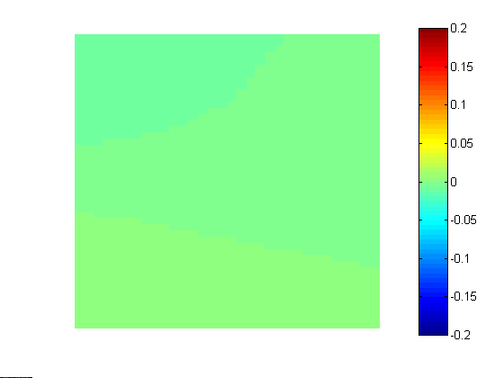
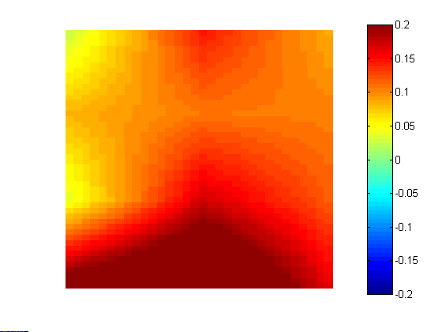
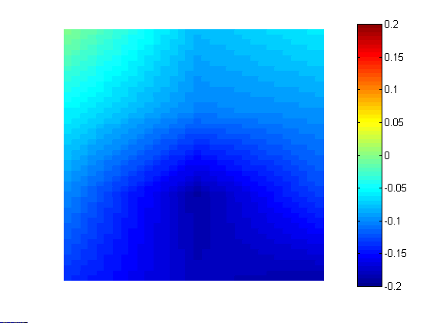
Oxygen saturation during standing plantar flexion in medial head of gastrocnemius muscle
(o.d.)
0.2
0.1
0.0
-0.1
-0.2
deoxygenation
oxygenation
Rest
Exercise
Recovery
Right Leg
Miura et al. Jpn J Physiol 2001

Slide 11
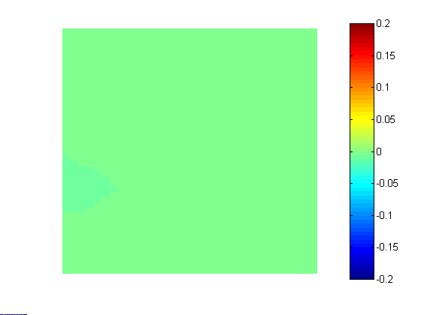
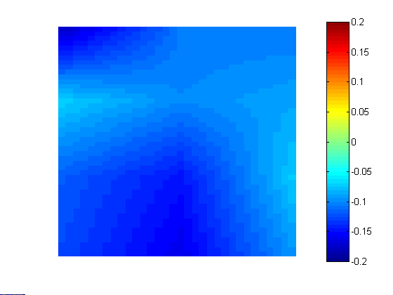
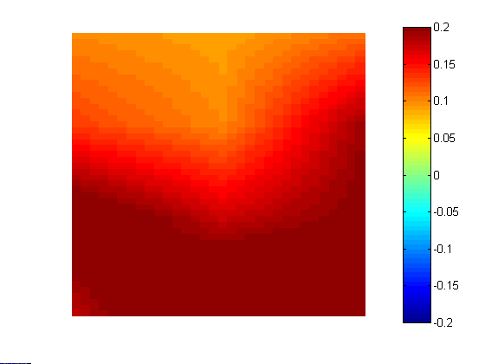
Blood volume during standing plantar flexion in medial head of gastrocnemius muscle
(o.d.)
0.2
0.1
0.0
-0.1
-0.2
increase
decrease
Rest
Exercise
Recovery
Right Leg
Miura et al. Jpn J Physiol 2001

Slide 12
What’s next?

Slide 13
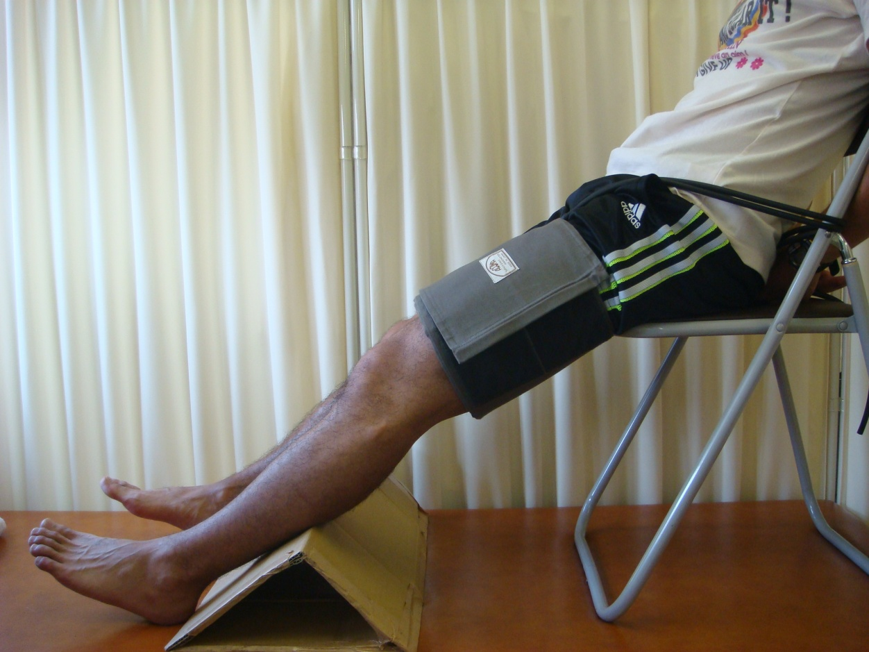
Change of oxygeation during thigh occlusion test
●: PVD ●: Healthy
oxy-Hb (μmol)
occlusion
recovery
(sec)
Miura H, Okumura N Adv Exp Med Biol 2010

Slide 14
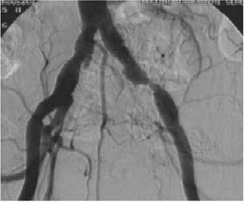
Recovery time in PVD patients and healthy subjects
The larger number indicates the more severe of PVD
Recovery time (sec)
healthy
1 2 3 4 5 6
PVD
Miura et al. Spectroscopy 2002

Slide 15
Recovery time in PVD patients and healthy subjects
#5’ and #6’ indicate the data after taking medication
Recovery time (sec)
healthy
1 2 3 4 5 6
5’ 6’
PVD
Miura et al. Spectroscopy 2002

Slide 16
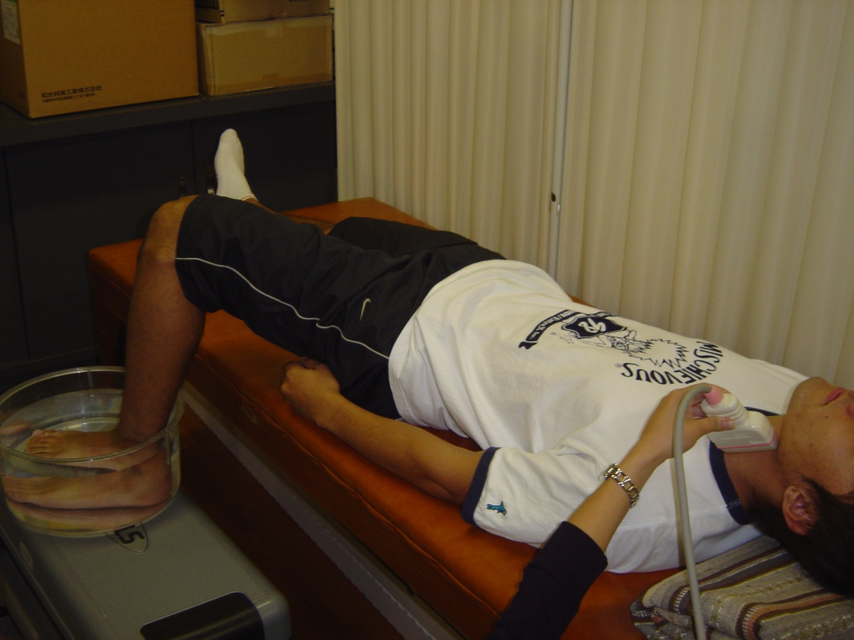
Change of oxy-Hb during cold pressor test
■: Hypertensive group ■: Healthy group
oxy-Hb (o.d.)
Rest
Cold Pressor Test
(sec)
Miura et al. JJCA 2011

Slide 17
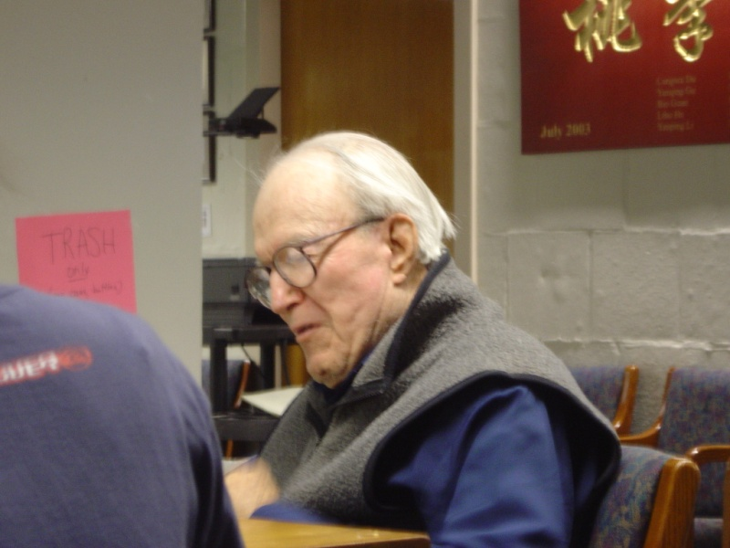
Prospect of NIRS
1) Owing to Chance’s great achievements,
improvements in NIRS have matured this
technique to be applicable for a wide range
of applications
2) NIRS is still prospective
technology and in the future
this kind of tool might play a
crucial role in diagnosing,
treating some diseases, or
defining therapy process

Slide 18
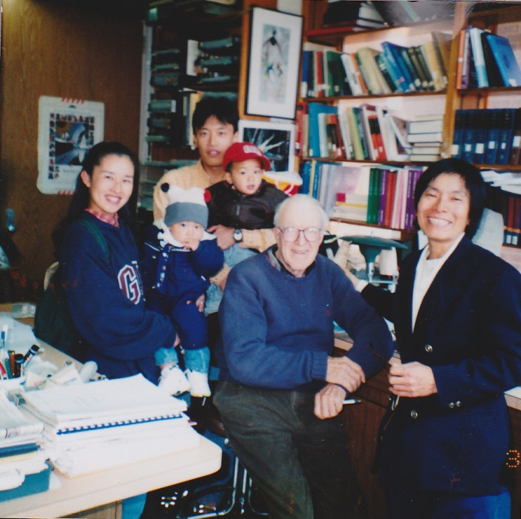
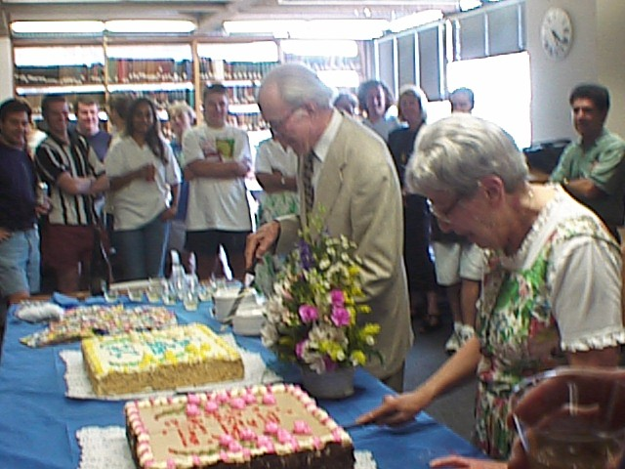
My BC’s memory
Toward research, Britton Chance was strict and showed no willingness to compromise
Britton Chance will be greatly missed as a great scientist in exercise physiology and clinical medicine

Slide 19
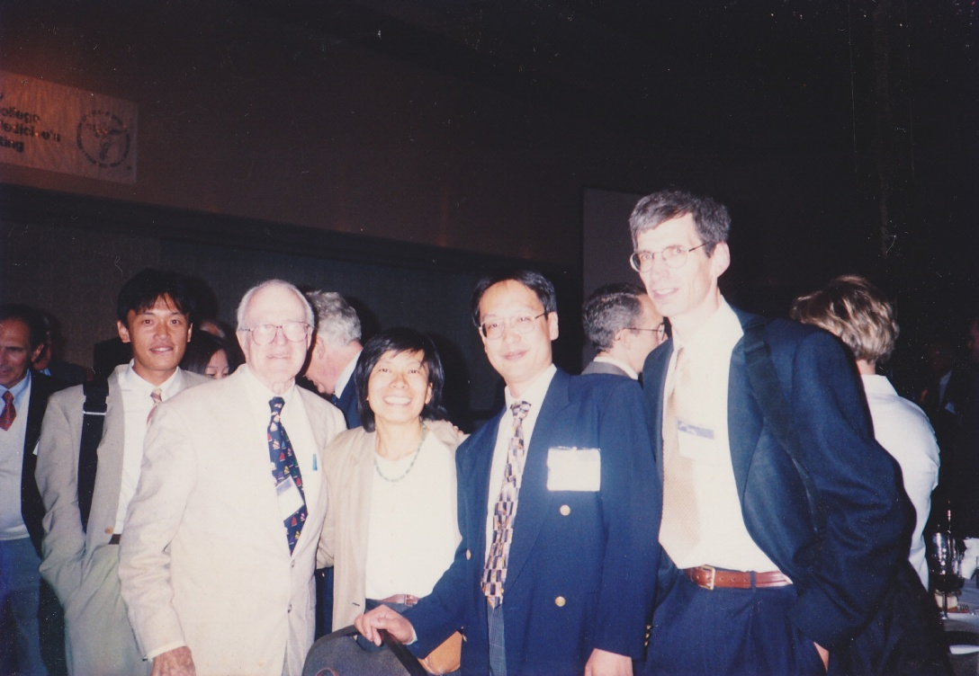
With deepest regret, Hajime Miura

