Slide 1
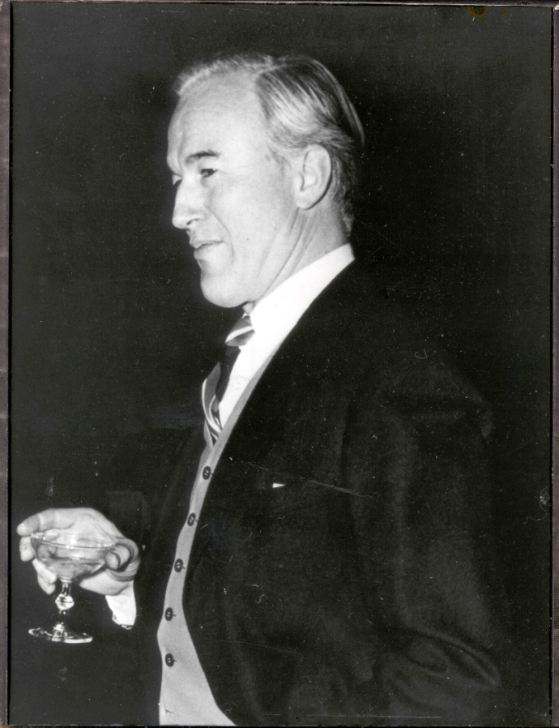
A Beacon for Creativity and Innovation
Britton Chance

Slide 2
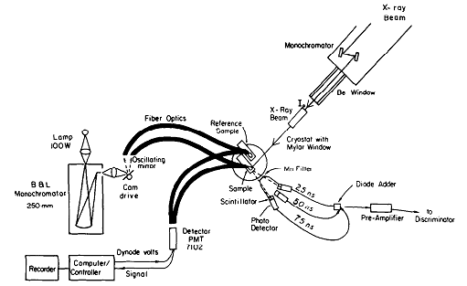
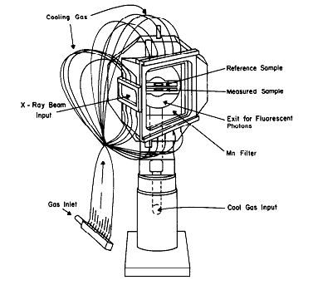
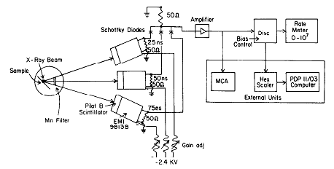
Instrumentation for X-ray Absorption
and Optical Spectroscopy

Slide 3
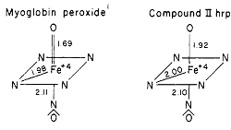
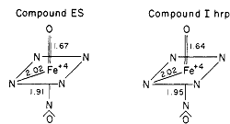
Active Site Similarity of Myoglobin Peroxidase with Peroxidase Intermediates
Chance, Powers, Ching, Poulos, Yamazaki 1984
M Chance, Powers, Kumar, Chance 1986
M Chance, Powers, Poulos, Chance 1986

Slide 4
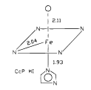
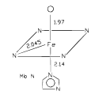
Effects of Proximal Histidine Altered H-bonding
CcP D235N
CcP W191F
Mb L89D
Mb L89V
Mb L89I
cytochrome c peroxidase [CcP]
myoglobin [Mb]
H-bonding to proximal histidine controls
Fe- heme nitrogen distances
O ligand distance
Sinclair, Hallam, Chen, Chance, Powers 1996

Slide 5
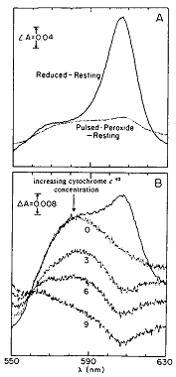
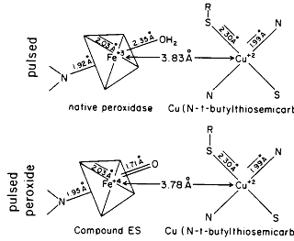
Peroxidatic Form of Cytochrome c Oxidase
Kumar, Naqui, Powers, Ching, Chance 1988

Slide 6
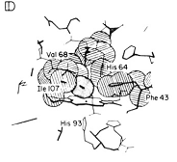
Geminate States of MbCO
Chance, Fischetti, Powers 1983
Powers, Sessler, Woolery, Chance 1984
Powers, Chance, M Chance, Campbell,
Friedman, et al 1987

Slide 7
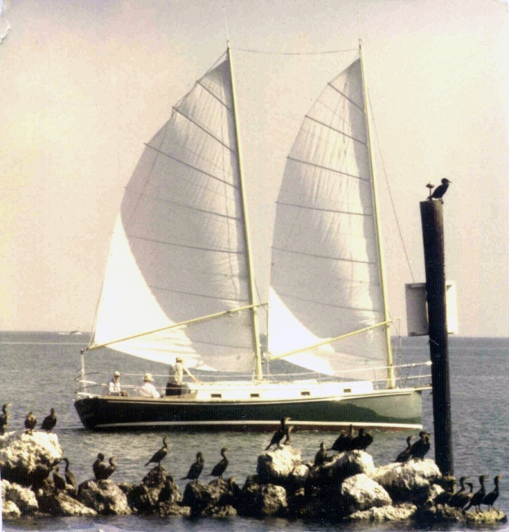
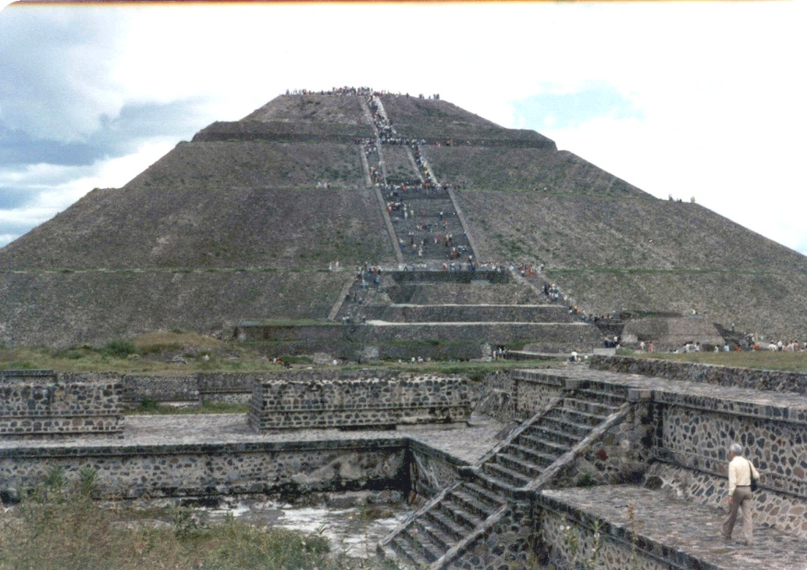
Stories
Egret
Marathon
Teotihuacan

Slide 8
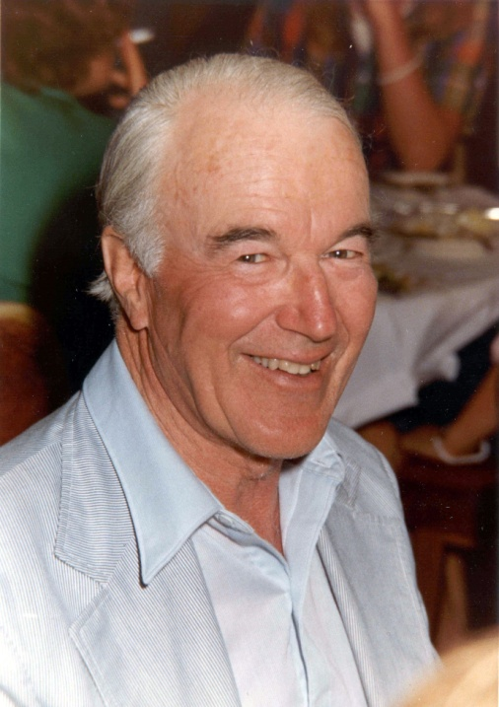
Thank You, BC!

